Slide 1
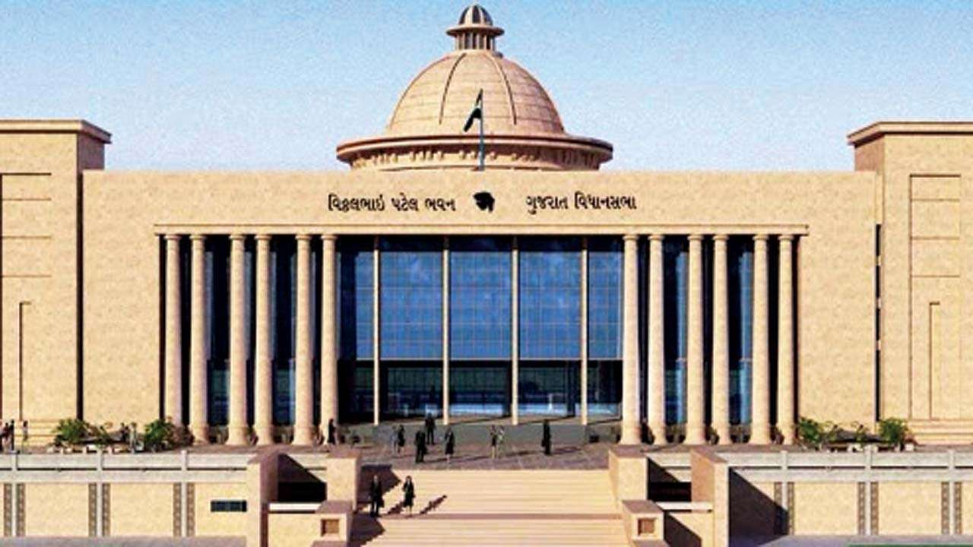
Presentation for
eSarkar Training

Slide 2
Web module details
Core Modules
Citizen Centric Module
Departmental Modules
E-Tappal
E-File
Office Note
MP-MLA References
GOI Reference
E-Meeting & Committee Management
Public Grievance
(https://esamadhan.gujarat.gov.in/ )
RTI Management
(https://onlinerti.gujarat.gov.in/ )
Appointment Scheduler
(https://esampark.gujarat.gov.in/ )
1. LAQ Management
2. Award Management
3. Legal Case Management
4. Audit Paras
5. Record Management
6. Knowledge Repository
7. Asset Management
8. Circular Management
Integration Source
OTHER APPLICATIONS
Citizen Grievance Redressal Portal
HRMS- SATHI
SWAGAT
eCourt
Email, SMS & eSign
HRMS- SATHI
2

Slide 3
e-Sarkar Geographical Coverage
State Departments
State Departments
State Departments
HoDs
All Commissionerate’s
Other important offices of Government of Gujarat
Mamlatdar/ districts/ taluka level offices
HoDs
Phase-1
State Departments
HoDs
All Commissionerate’s
Other important offices of Government of Gujarat
Mamlatdar/ districts/ taluka level offices
HoDs
e-Sarkar
e-Sarkar
All Collectors Office
All Commissionerates
Phase-2
All Collector Offices,
Mamlatdar and other districts & taluka level offices
All Collectors Office
All Commissionerates
All Collector Offices,
Mamlatdar and other districts & taluka level offices
Other important Government Offices
Other important Government Offices

Slide 4
Login Screen
Enter User Id
Enter Password
Enter Captcha
Enter here to login
Access e-Sarkar using https://esarkar.gujarat.gov.in/

Slide 5
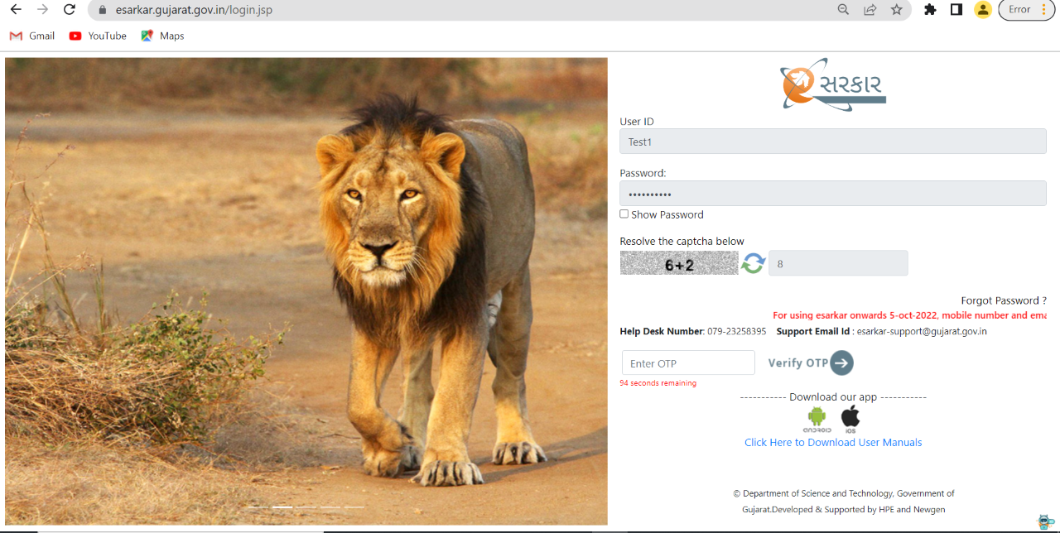
Login Screen with OTP via Internet
Enter OTP
Access IWDMS 2.0 using https://esarkar.gujarat.gov.in/

Slide 6
Tappal/MP-MLA/GOI Inward Registry Process
Registry Clerk will login into eSarkar with his/her Login Credentials.
Registry Clerk will Click on the Quick Menu of e- tappal/MP-MLA letter/GOI letter.
Clicks on ‘Register Tappal’ Link.
Fills metadata and upload the softcopy of the tappal/MP-MLA/GOI.
Submits the e- tappal/MP-MLA/GOI.

Slide 7
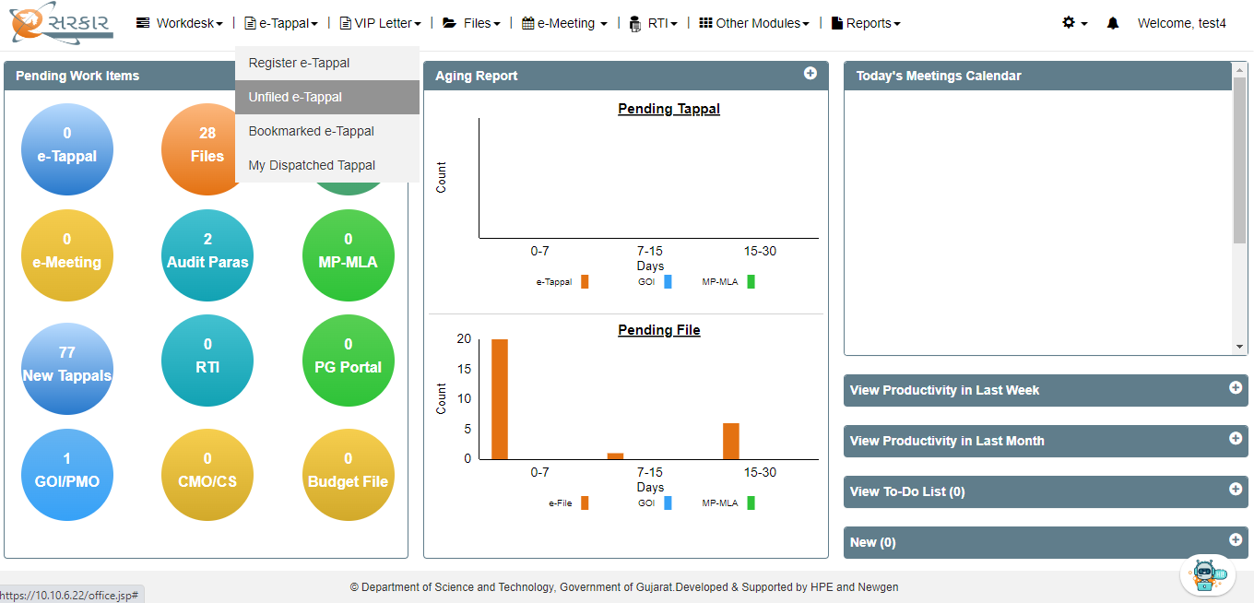
Check New eTappal
Click Here on unfiled e-Tappal to see new e-Tappal

Slide 8
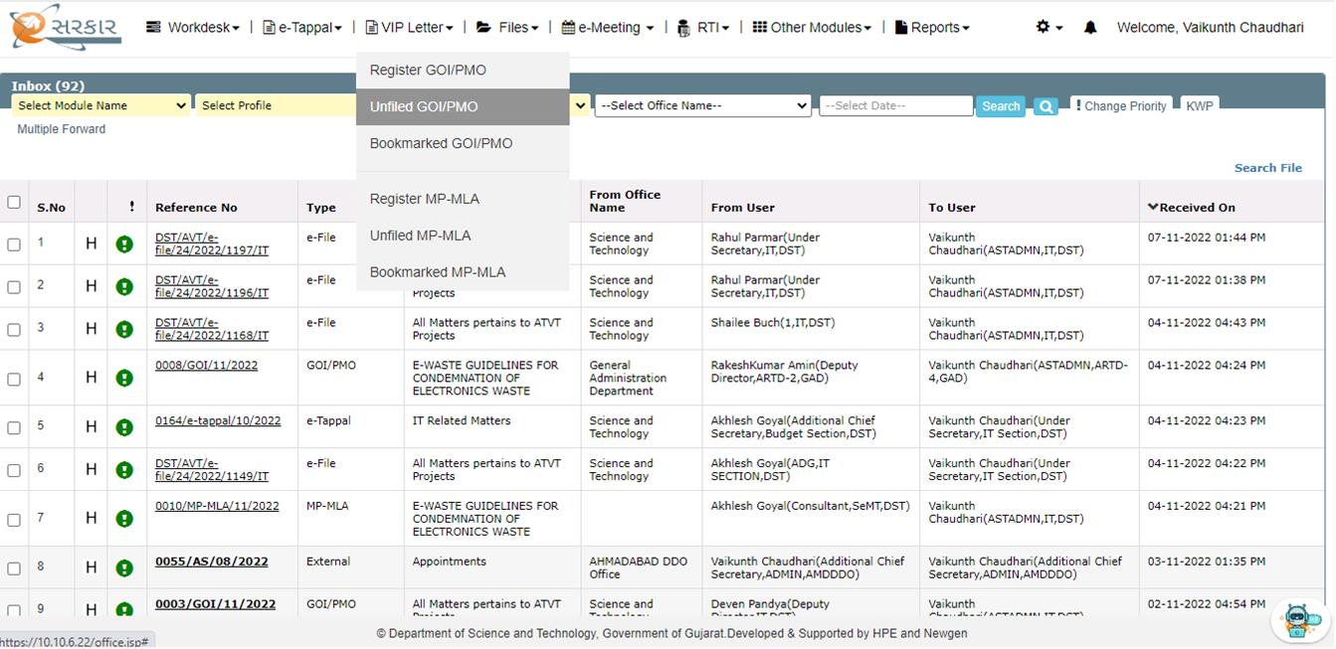
Check New GOI-PMO
Click here GOI-PMO Unfiled tappal

Slide 9
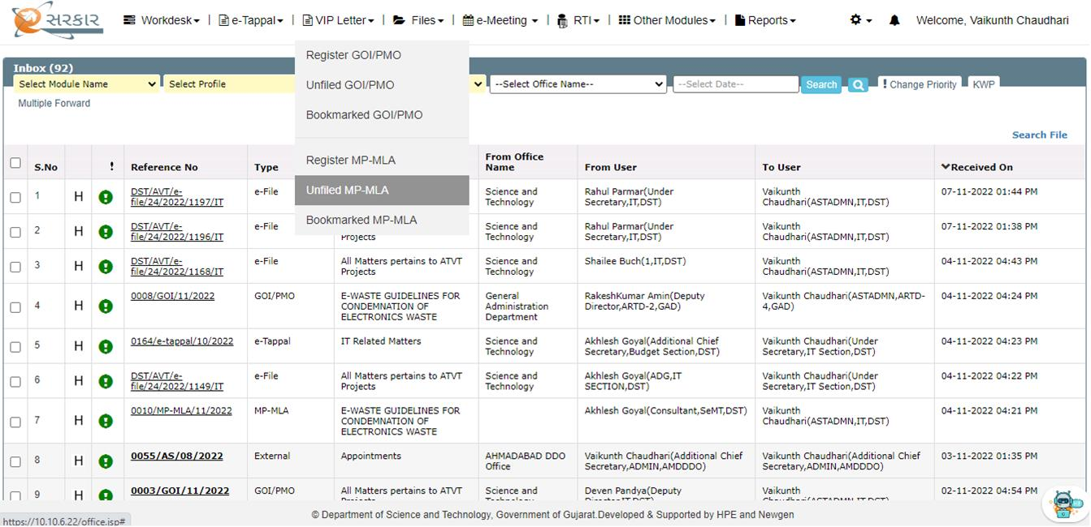
Check New MP/MLA
Click here

Slide 10
Unfiled eTappal (Tappal Submitted to you)
User can take action from here after selecting e-tappal
Click here to see all KWP marked e-tappal
Click Here to see e-tappal details
Click her to see all e-tappal transferred by you
Click here the tappal on which you have taken action

Slide 11
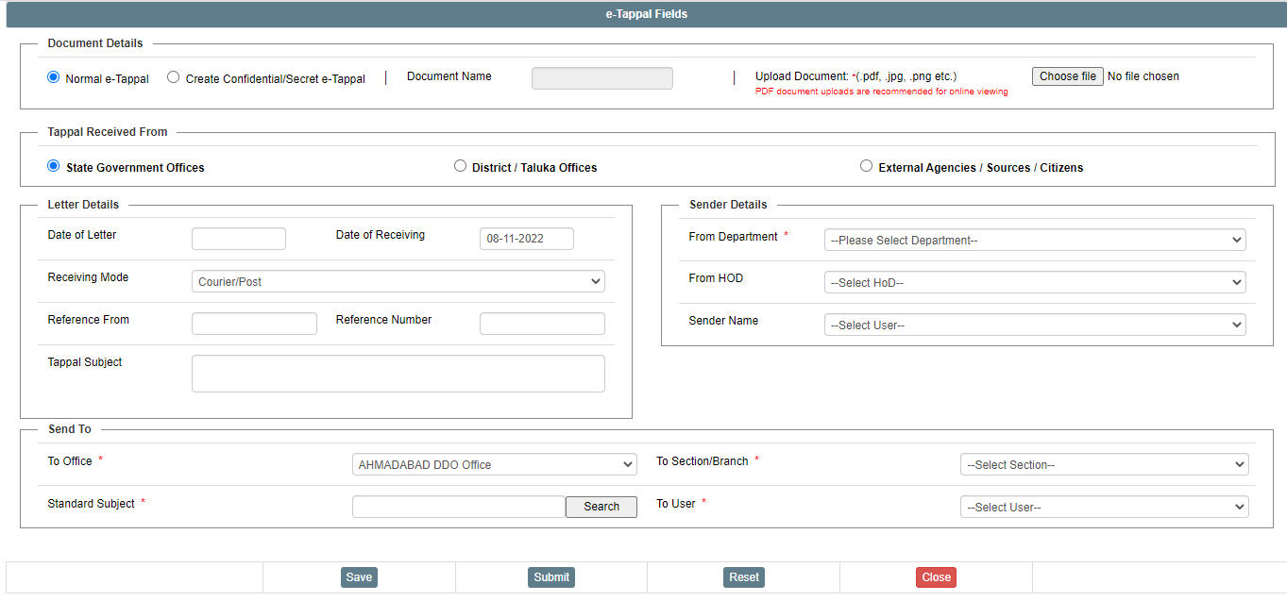
E-TAPPAL REGISTRATION SCREEN
Upload Scanned Tappal
Click Here to SAVE the Tappal
Click Here to SUBMIT the Tappal
Click Here to Reset all fields
Click Here to CLOSE the Window

Slide 12
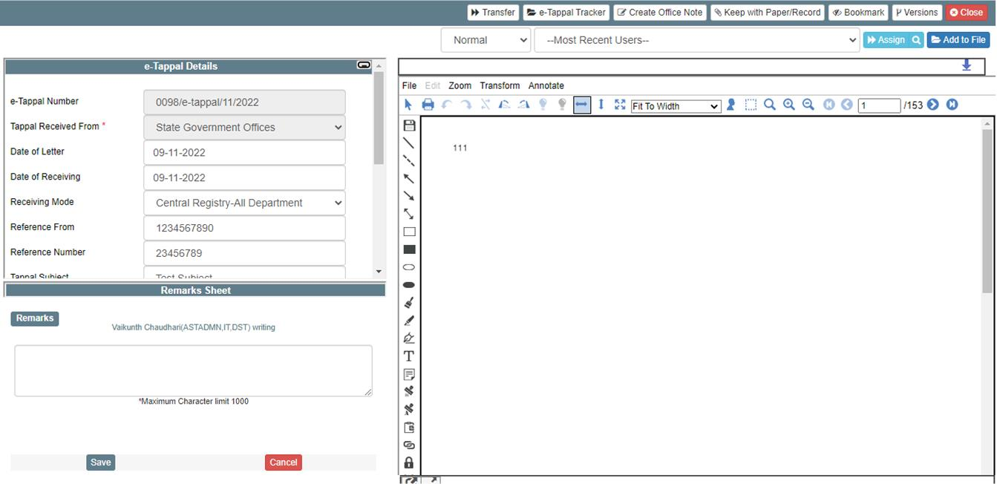
eTappal Details
BookMark
Transfer e-tappal to other user
Click here to see e-tappal properties
Add e-tappal to file
Here you will see all remark
Create new
remark
Tappal scanned copy will be
visible here

Slide 13
Assign Tappal
Select route
Advance Serach
Select most recent user you have used
Select priority
We have given predictive search to select the user in To and CC. Please note that user can select multiple users in To and CC.

Slide 14
Inbox of Concerned User
Click here
Check newly assigned e-tappal
Check tappal you sent
Check e-tappal you have cc to others
Check newly cc e- tappal

Slide 15
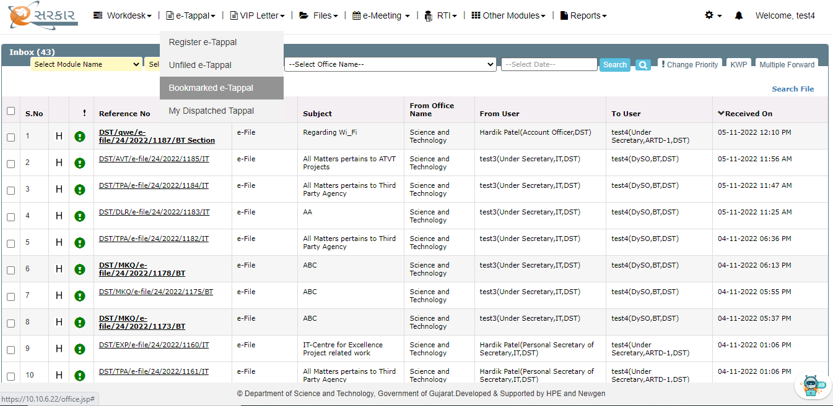
To Check Bookmarked Tappal
Click Here to see all Bookmarked e-tappal

Slide 16
Inbox (eTappal assigned to you)
Click Here to check e-tappal details

Slide 17
CONVERT TAPPAL INTO E-FILE
E-TAPPAL AND E-FILE

Slide 18
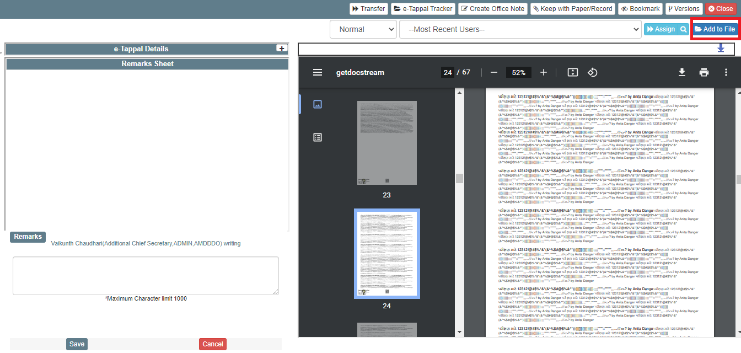
eTappal Details
Forward – Send tappal to other user
Return – Return tappal to last user
Refer – Send tappal for refer to any user
Clarify – Clarify from any user which is part of flow (in the chain of tappal flow)

Slide 19
Convert eTappal to eFile
Convert e-tappal to new e- file
Convert e-tappal to existing e-file

Slide 20
Add eTappal to Existing eFile
Click here for existing e-file
Search existing files here

Slide 21
Add eTappal to Existing eFile
Click here for Search
Select existing file here
Click here to add file

Slide 22
Add eTappal to Existing eFile
Click here to add file

Slide 23
CREATE NEW FILE
E-TAPPAL AND E-FILE

Slide 24
Create New eFile
Create New File

Slide 25
eFile Creation
Click here to Create
Write Description of File
Predictive predefined File Subject
Select File Plan

Slide 26
Newly Created eFile
Add New Attachment
Print Note
Enclosur e
Assign File
Add Note
Edit Note
ALL Noting will be visible here
Link Note
Delete
Note

Slide 27
Assign eFile
Select route
Select most recent
user you have used
Select priority
We have given predictive search to select the to whom you want to assign the file

Slide 28
Check New eFile Assigned to You
Check newly assigned e-file

Slide 29
Inbox
Click to check e-file details

Slide 30
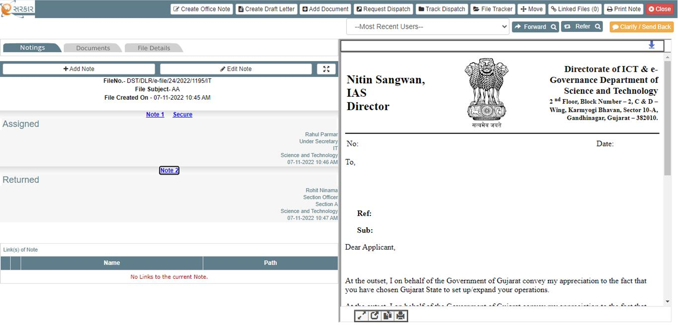
eFile View
Forward – Send tappal to other user
Return – Return tappal to last user
Refer – Send tappal for refer to any user
Clarify – Clarify from any user which is part of flow (in the chain of tappal flow)
Approve – Approve the file and send back for completion
Only Creator of e-file will able to complete the file

Slide 31
Forward eFile
Click here to send e-file
Click here to select route
Click here to exit screen
Enter username here
Click here to change priority

Slide 32
Create Draft Letter
Click here to Create Draft Letter

Slide 33
Create Draft Letter
Click here to select template
Enter here
Click here to save template

Slide 34
Create Draft Letter
Enter the name of Draft Letter and Add

Slide 35
eSign after Approval & Approve with eSign
Scenario 1: Approver can only approve the file which will be sent to initiator. Initiator will then send the file to User for eSign
Scenario 2: File can be Approve and eSign directly.

Slide 36
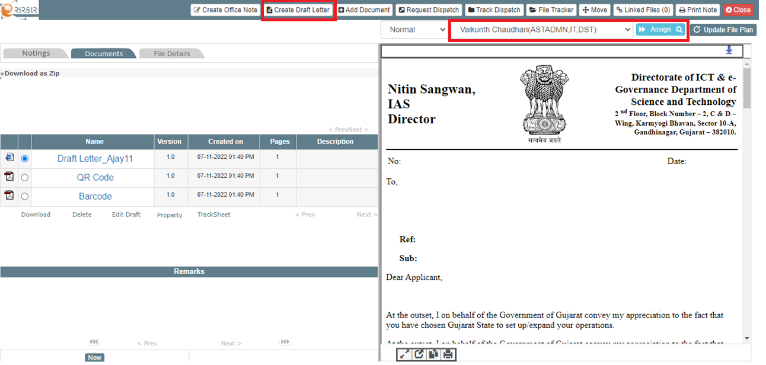
Scenario 1:
eSign after Approval Process: Step 1: The initiator user creates the file and then creates a draft letter and assigns it to the user for further process.

Slide 37
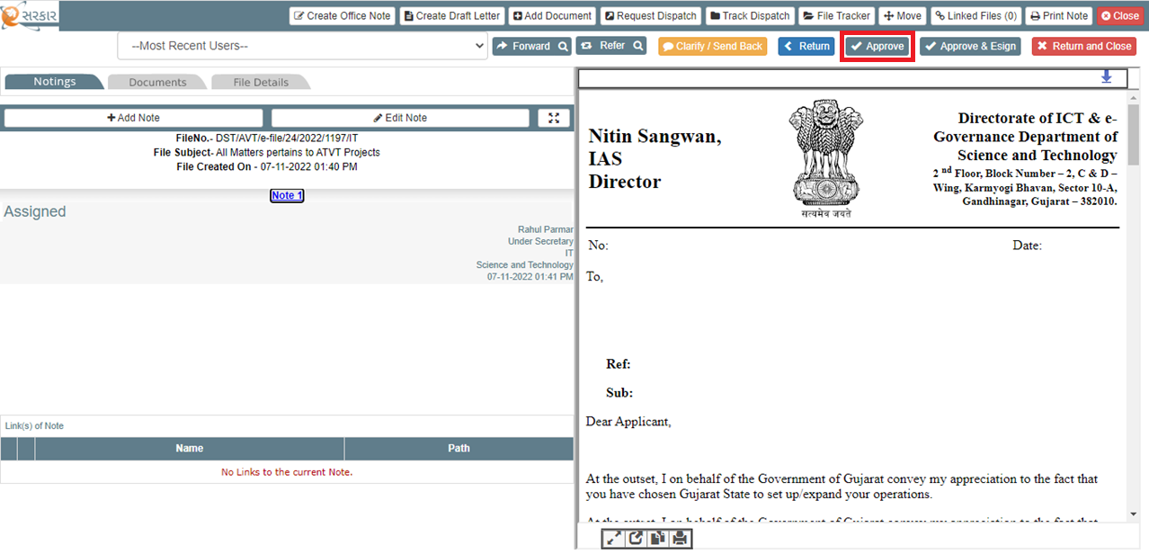
Step 2: Authorized user receive the file, user can approve the file. HTML convert into PDF with QR Code and File No.

Slide 38
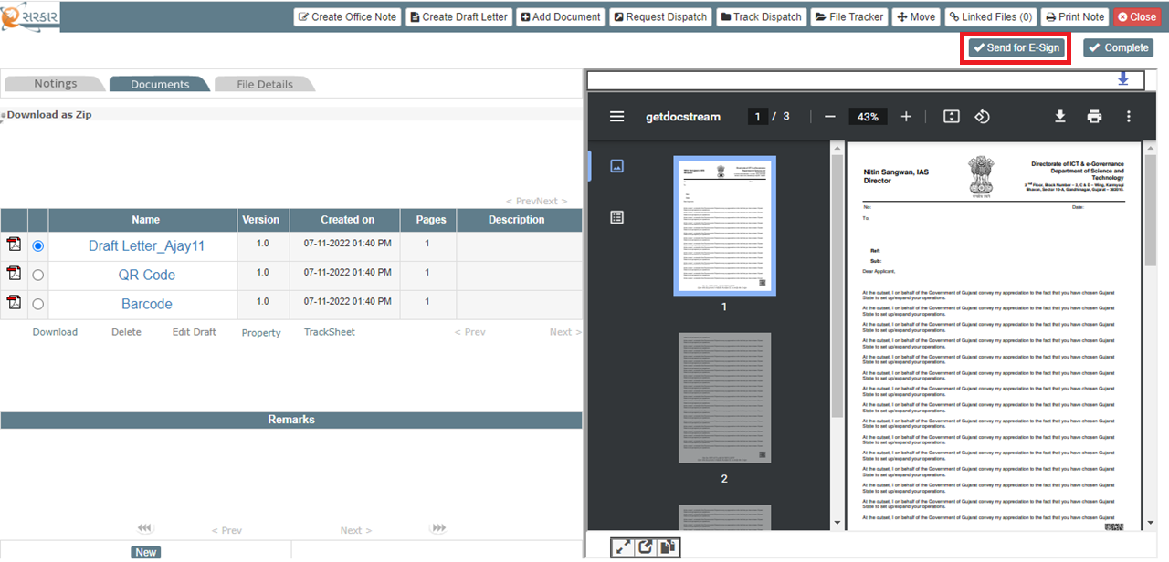
Step 3: Once the Authorized user approves the file and sends it back that file to the initiator user, the initiator user sends draft letters for eSign with help of the “Send for e-Sign” button.

Slide 39
Step 4: The initiator user selects any flow user name and sends a file to that user to perform e-Sign.

Slide 40
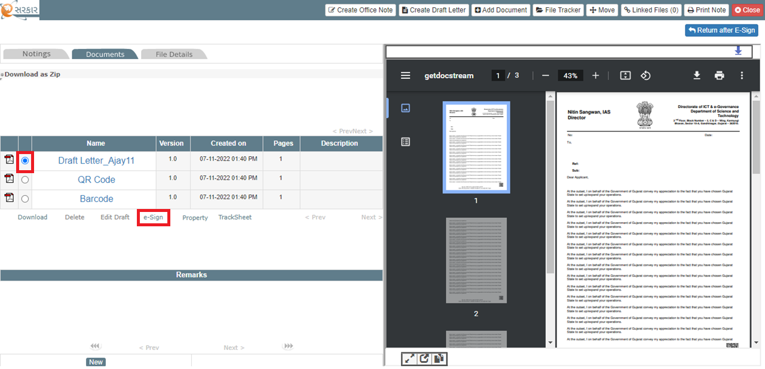
Step 5: Authorized user selects the document and clicks on the e-Sign link for the further process.

Slide 41
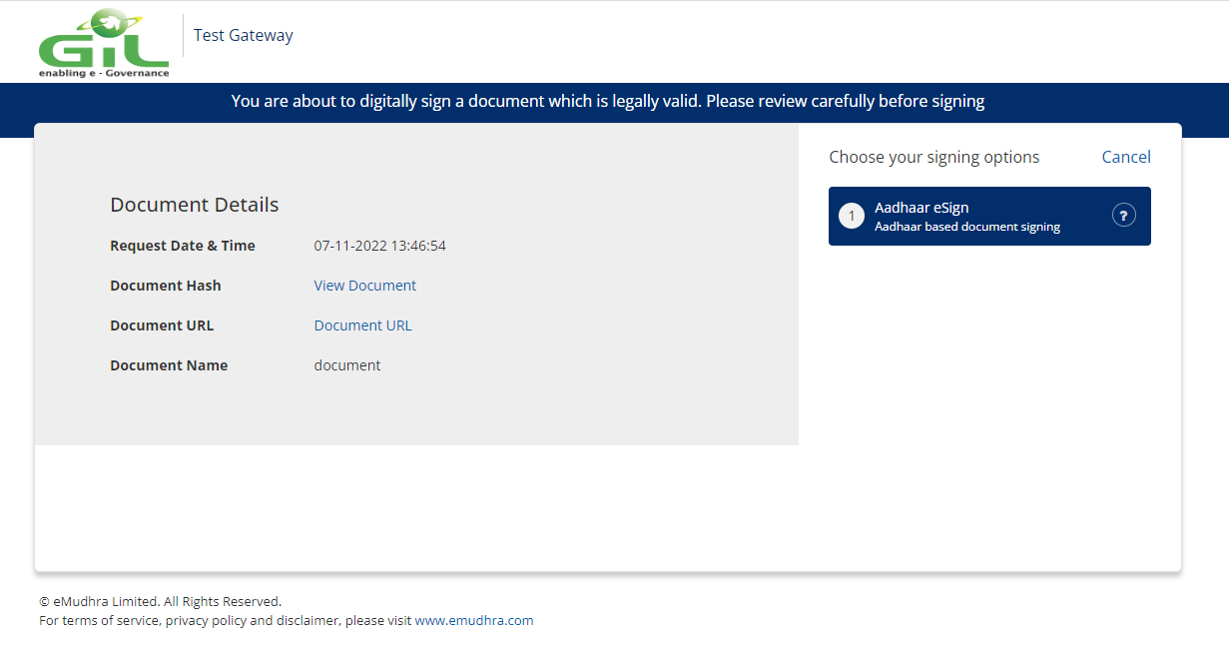
Step 6: Authorized user clicks on the Aadhar eSign button.

Slide 42
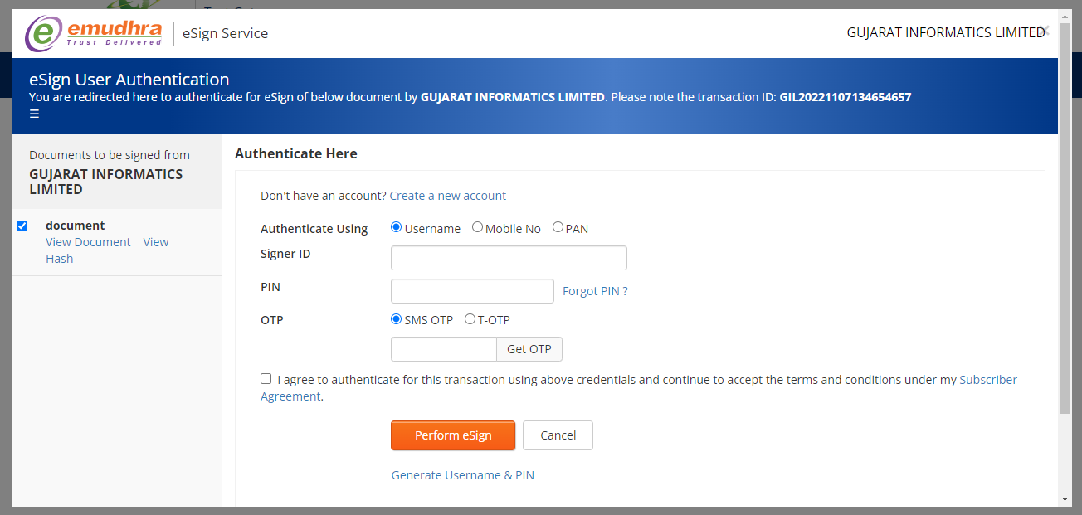
Step 7: Authorized user submit all details and click on Perform eSign button.

Slide 43
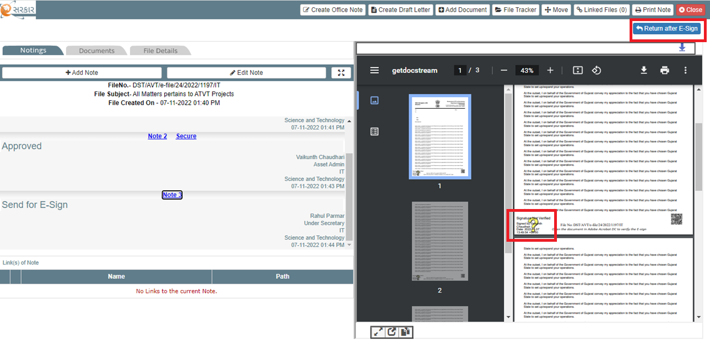
Step 8: After e-Sign process, the user views the eSign at bottom of the every page and returns that file to the initiator

Slide 44
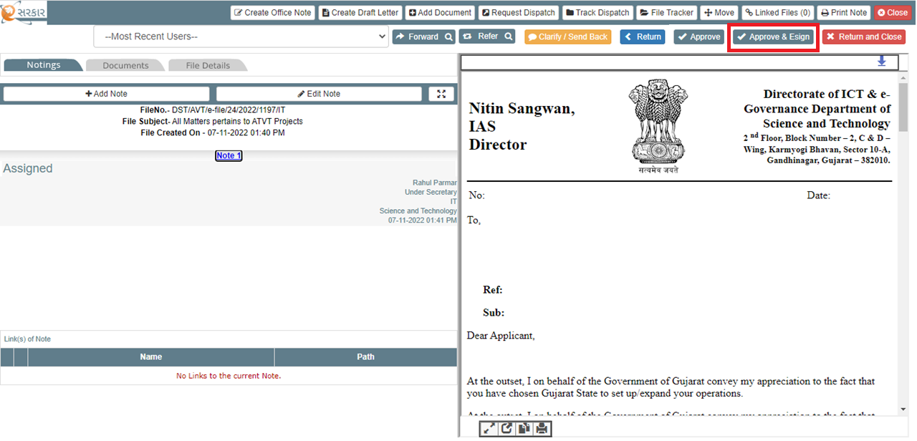
Scenario 2:
Step 1: The initiator user creates the file and then creates a draft letter and assigns it to the user for further process.
Step 2: Authorized user receives the file, user can click on the “Approve & eSign” button. HTML file converts into PDF with QR Code and File No.

Slide 45
Step 3: After Approve & eSign, the file is approved and ready for eSign, user selects the document and clicks on eSign link for further process. The rest of the other steps are the same as per Approve process.

Slide 46
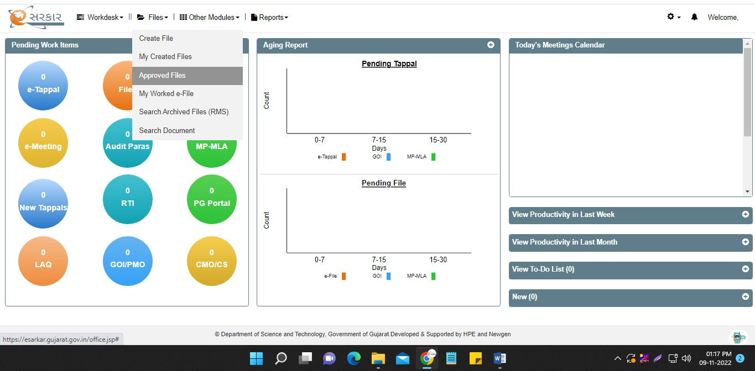
Approved eFile Intimation
All the people in flow will get intimation is e-file is approved

Slide 47
Approved eFile Intimation

Slide 48
Search eFile
Search e-file

Slide 49
Search eFile
Search e-file using the criteria selected

Slide 50
eMeeting Key Features
Meeting Scheduler
Minutes of meeting
Action Tracker
Schedule Meeting
Creation of Agenda
Formation of meeting committee
Accept/Reject Meeting invitation
Nomination of other official for a meeting
Reschedule a meeting
Cancel a meeting
Draft creation of MOM
Approval of MOM
Circulation of MOM
View MOM
Create action tracker for the meeting
View action tracker
Update action tracker
Assigning of action item
Action item completion

Slide 51
Features of eMeeting
User Can Create Three types of Meeting
Ad Hoc Meeting
Formal Meeting
Committee Meeting
User will get Meeting Calendar where they can see all their scheduled Meeting.
Mobile Application is available from where user can accept/reject meeting invite and can check all the details of e-meeting module which is available on web
User will get the meeting invitation notification on SMS and email of High and Very High priority meeting.
4

Slide 52
Features of eMeeting
If user wants to have a meeting with on short notice with his colleague/or any other officials without any formal invitation they can create the Ad Hoc Meeting.
There no need to appoint Chairman and Convener.
No need to add any agenda for initiation of meeting
No need to ask for approval for convening the meeting
Option of sending e-invitation or formal invitation
No need to create MOM or actionable
Adhoc Meeting
If user wants to Create a formal meeting, an approved agenda is compulsory to initiate the same
Chairman and Convener are mandatory
Need to send the meeting for approval
A formal invitation will go to all members whenever meeting is approved.
Intimation will be shared by Email & SMS.
Formal Meeting
5

Slide 53
Features of eMeeting
First User need to create the committee
Committee circular will be sent to all members of committee
If user wants to Create a Committee meeting, an approved agenda is compulsory to initiate the same
Chairman and Convener are mandatory
Need to send the meeting and committee for approval
A formal invitation will go to all members whenever meeting is approved
Committee Meeting
System will generate below templates as per office procedure
Committee Circular
Submitted Committee Circular
Agenda Details
Meeting Invite
Minutes of Meeting
Meeting Details
Templates Generated in Formal and Committee Meeting
6

Slide 54
User Dashboard
Click here
8

Slide 55
eMeeting Dashboard
Today’s Meeting will be visible here
Meeting Invite will be visible here
This is Meeting Calendar, where all future meeting will be visible.

Slide 56
Meeting Invite
User can see all meeting invite by clicking here
13

Slide 57
Meeting for Approval for Formal Meetings (INBOX)
Click Here to see meeting details
Click on Inbox to see any new pending work item. From here user will get meeting detail received for approval
16

Slide 58
Meeting Invitation After Approval of Meeting
EMAIL
SMS
View and Tracking on Mobile App available in eSarkar
18

Slide 59
COMMITTEE CIRCULAR
MEETING INVITATION
2
5

Slide 60
28
Creation of MOM
Click Here to mark Attendance
Click Here to create MOM

Slide 61
29
Creation of MOM
Write the MOM here
User Name to whom MOM will go for approval with Remark
Click Here to send MOM for approval

Slide 62
Creation of Actionable
Actionable tab will open only if MOM are approved
Click Here to Create Actionable
31

Slide 63
Creation of Actionable
Write the MOM here
Click Here to Create the Actionable
User can select multiple users and | assign actions against the | same
32

Slide 64
Actionable of Meeting
Click Here to complete your actionable
Click Here to check your actionable
33

Slide 65
Future Enhancement / Upcoming Functionality

Slide 66
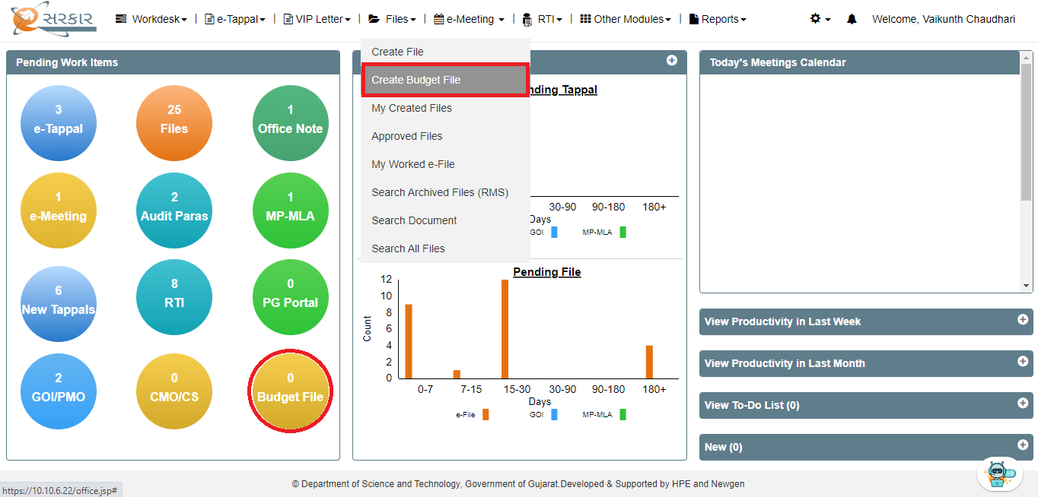
Budget File
File Creation: Will provide a separate link to create budget-related files. Files created using this link only would be considered as budget-specific files. The workflow of these files would be similar to other files created in the system. The system would internally handle the segregation of these files from the normal files.
User create Budget related file
User view the Budget related file(s) count

Slide 67
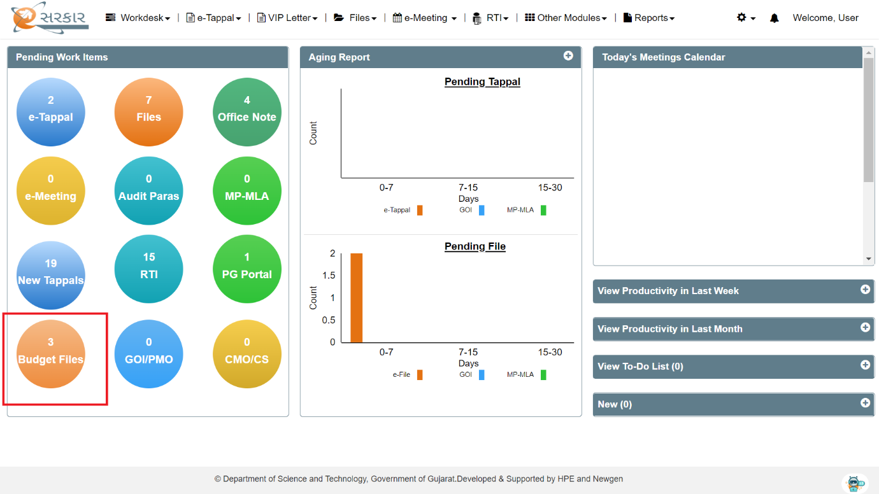
DAP-ST
Budget File
Quick link to access budget-related files: Will provide a quick link on the dashboard to access the budget-related files received in the inbox separately

Slide 68
Create Budget File

Slide 69
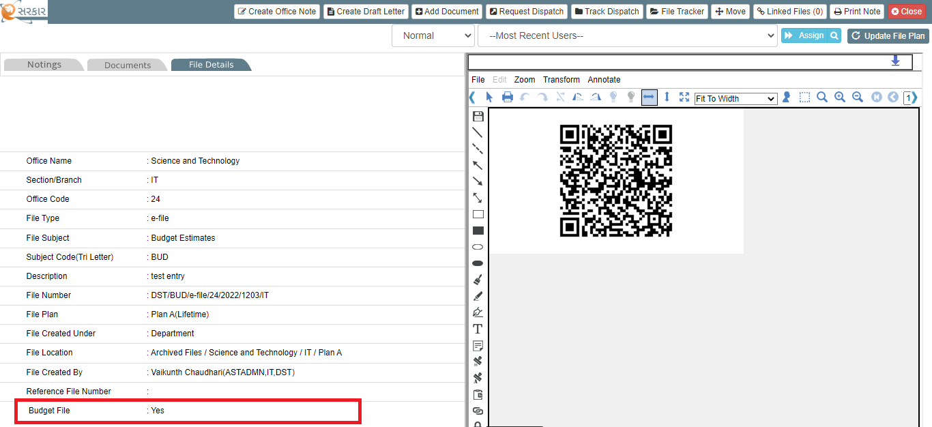
Budget File Status

Slide 70
Create Budget File

Slide 71
Budget File Status

Slide 72
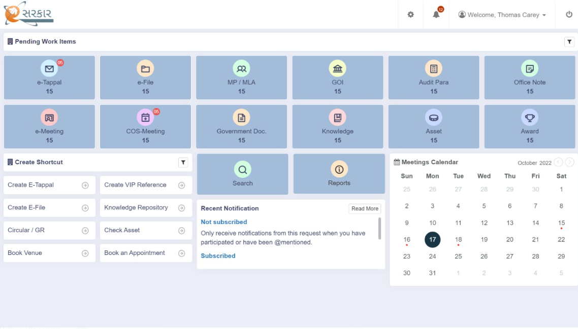
New Modern Landing Configurable* Dashboard
*Number of Visible Tiles can be changed by user as per convenience

Slide 73
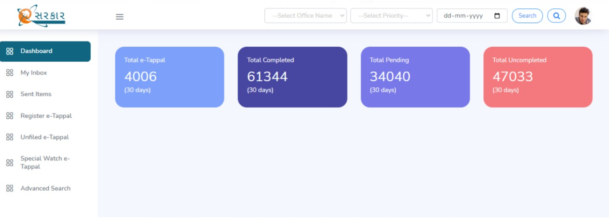
New Modern Landing Page of Modules

Slide 74
RTI Module

Slide 75
RTI Management
Register/Receive First Appeal
Create RTI (Received Offline)/
Receive Online RTI
PIO Level
APIO/DH/CO Level
Complete RTI
Complete First Appeal
FAA Review

Slide 76
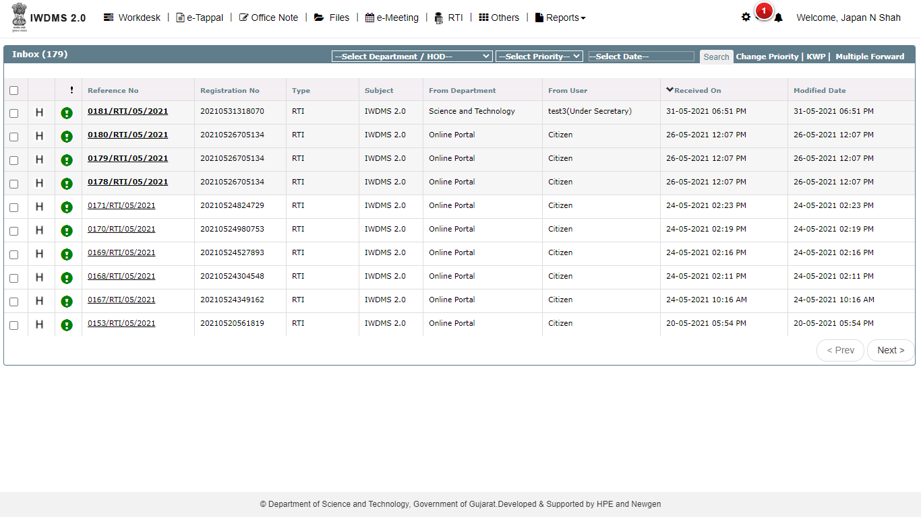
PIO Level
Once the RTI is initiated by the Registry user, the RTI will be allocated to the respective PIO. PIO user will click on the RTI menu and via inbox he will be navigated to the PIO screen

Slide 77
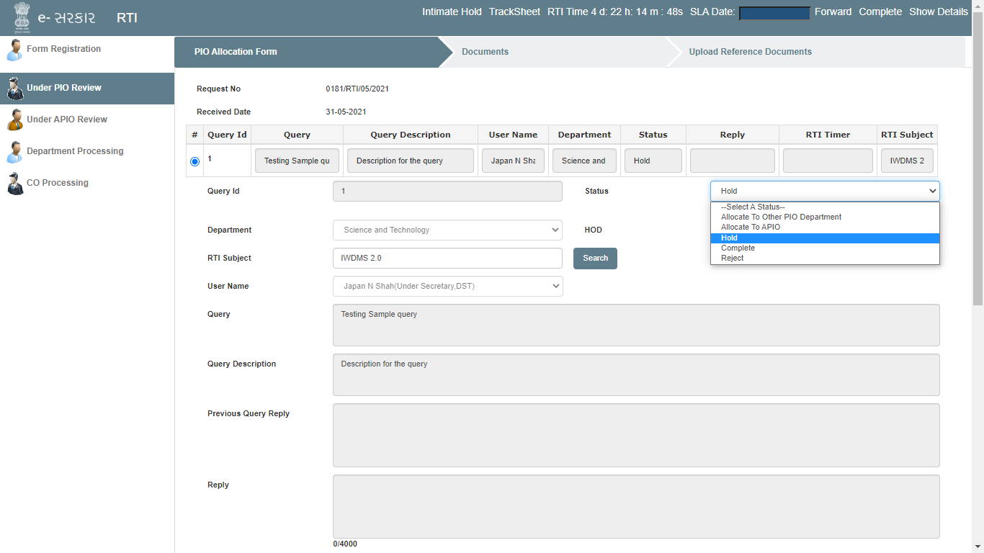
PIO Level

Slide 78
PIO Level
Under PIO Review tab, PIO will be able to see the following functionalities:
RTI Timer: PIO will select the RTI time according to the need for the RTI
Status: PIO can choose the status as:
Allocate to the other Department PIO
Allocate to APIO
Hold
Complete
Reject
Forward the RTI as per the status, while forwarding the RTI, PIO comments are mandatory.
SLA Date: This is an optional field provided to the PIO where PIO can enter the date before which the RTI need to be completed and sent to the citizen.
Show detail: Link at the upper right corner will display all the information regarding the RTI to the concern user.
Tracksheet: This link will show the tracker of the RTI.
Hold Functionality
PIO can intimate the citizen for visiting the office or other hearing details by selecting the status of the RTI as HOLD and enabling the intimate button.
While the status is on HOLD, the timer will be paused and will be resumed once the status is changed again from the HOLD.

Slide 79
APIO/ DH/ CO Level
Once the RTI is initiated by the PIO, the RTI will be allocated to the respective APIO. APIO user will click on the RTI menu and via inbox he will be navigated to the APIO screen
RTI Forward workflow:
PIO → APIO →DH → CO
RTI Return workflow:
CO → DH → APIO → PIO

Slide 80
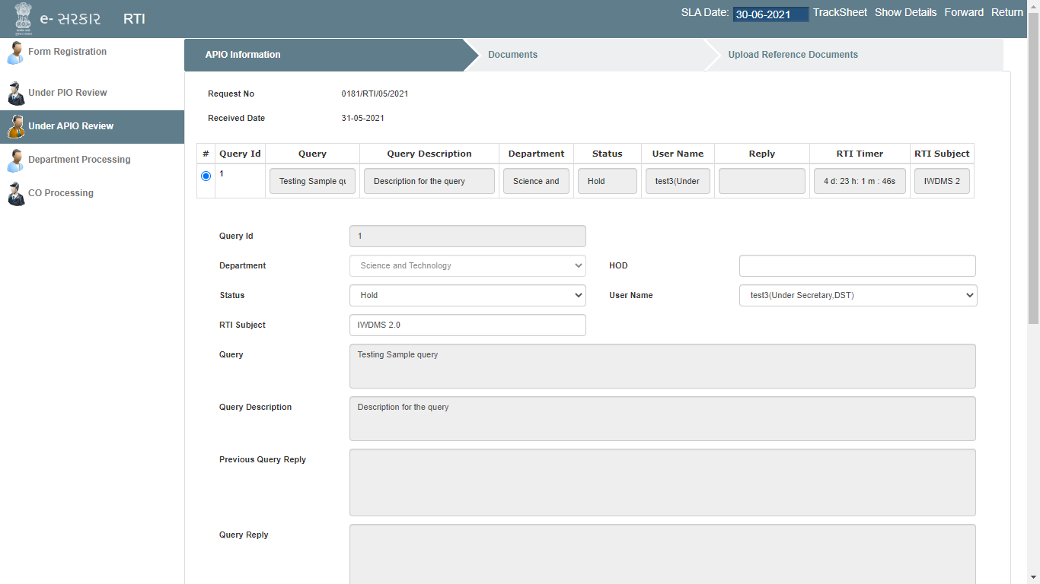
APIO/ DH/ CO Level

Slide 81
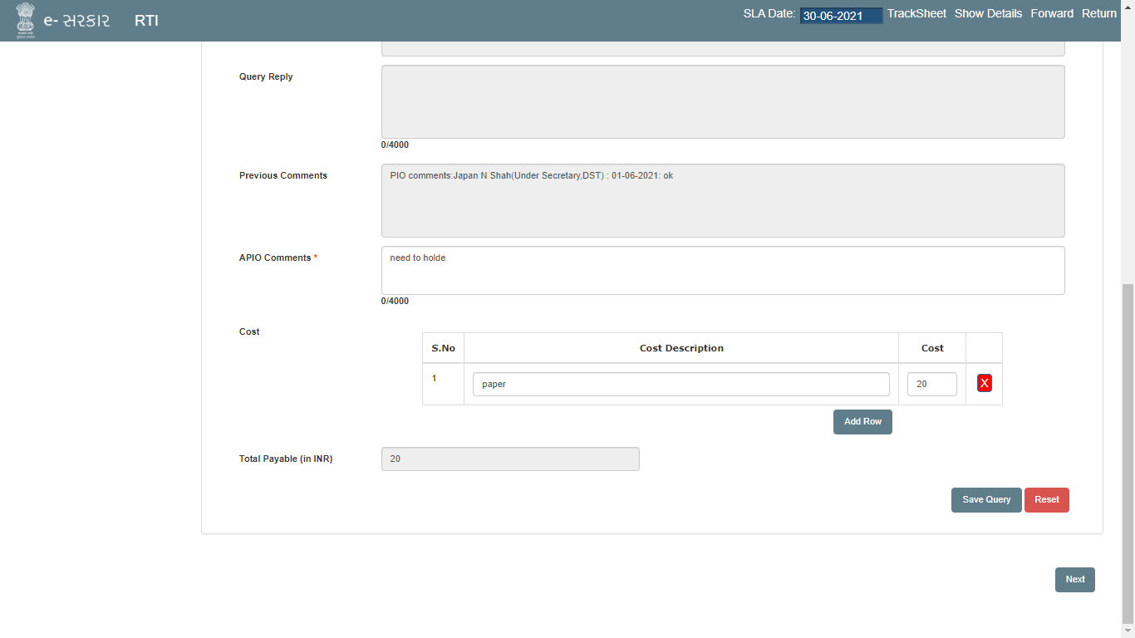
Additional cost
PIO/APIO/DH/CO users can add the additional cost in the Cost section mentioning the description and the value respectively
All the details entered must be saved by clicking on the “Save Query” button before forwarding or returning the RTI.

Slide 82
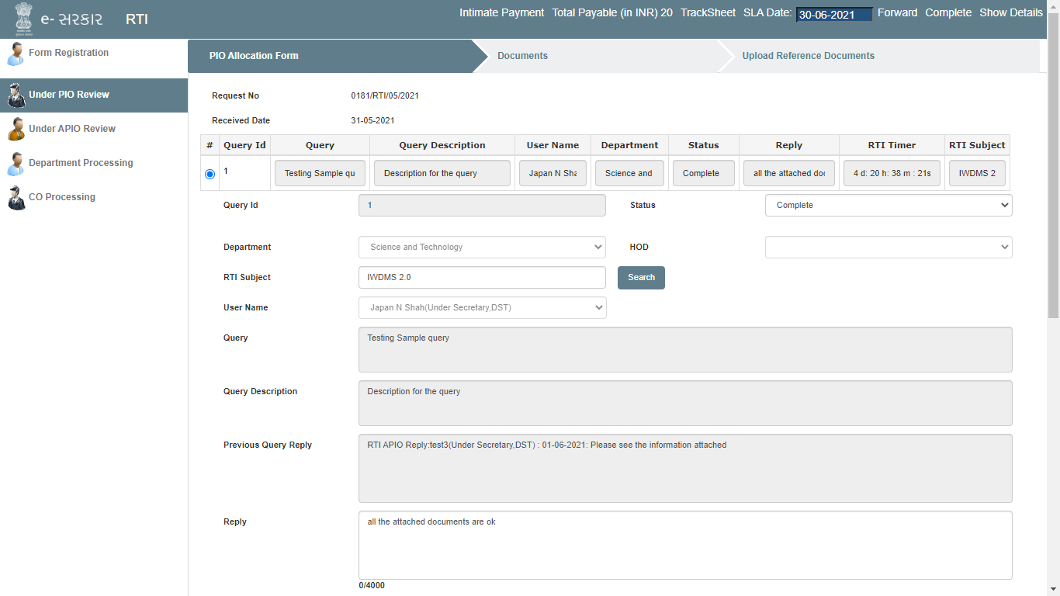
Intimate payment

Slide 83
Complete RTI
Once all the details has been captured and necessary documents has been uploaded by the APIO/DH/CO level users and RTI is sent back to PIO, PIO will be able to complete the RTI and send the uploaded documents to the citizen manually (if RTI is offline registered) or automatically (if the RTI is online registered via RTI portal) by clicking on the Complete button and keeping the status of the RTI as Complete.
Complete

Slide 84
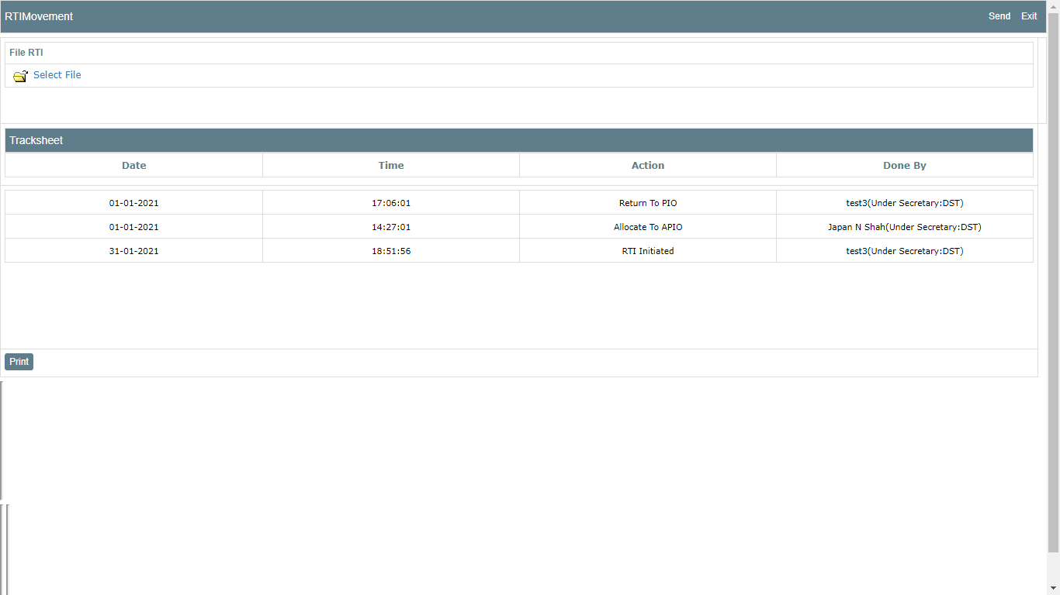
Complete RTI
RTI movement into the file

Slide 85
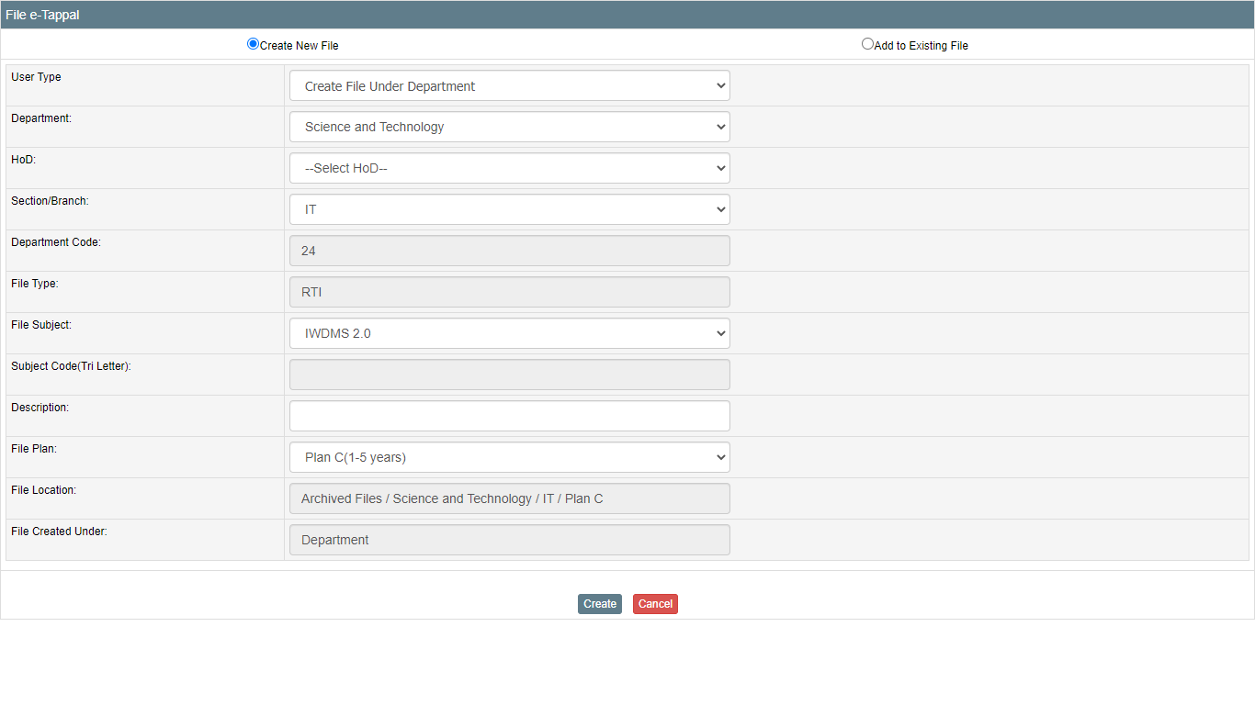
Complete RTI

Slide 86
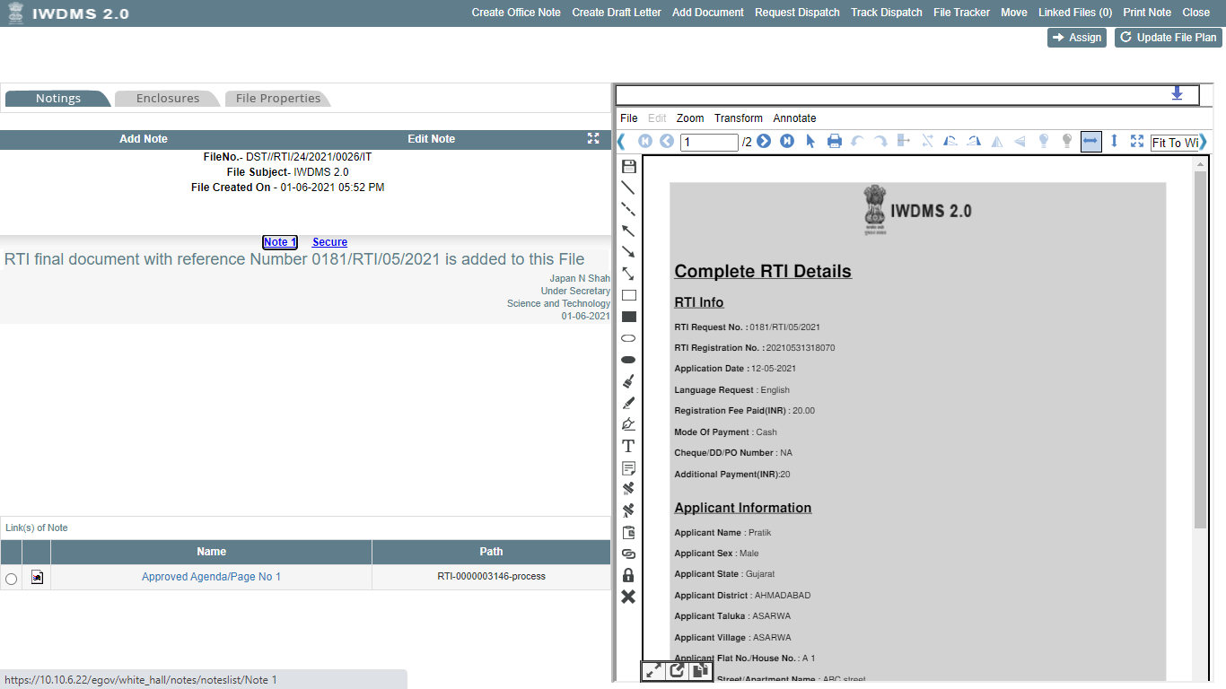
Complete RTI

Slide 87
Register/Receive First Appeal
Scenario 1: if original RTI was received offline and created manually in system, the first appeal also has to be raised in system manually
Scenario 2: if original RTI was received by online citizen portal, then citizen can raise first appeal after original RTI is complete or 30 days after creation of original RTI

Slide 88
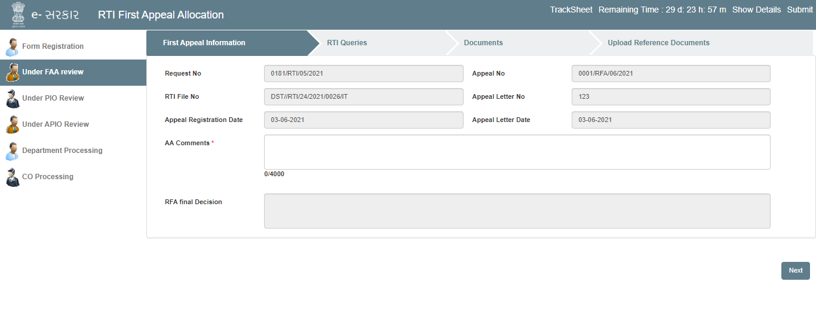
Under FAA Review
Once the FAA is received to the FAA user, FAA user will enter all the necessary details under all the FAA user tab and will assign it to the concerned PIO.

Slide 89
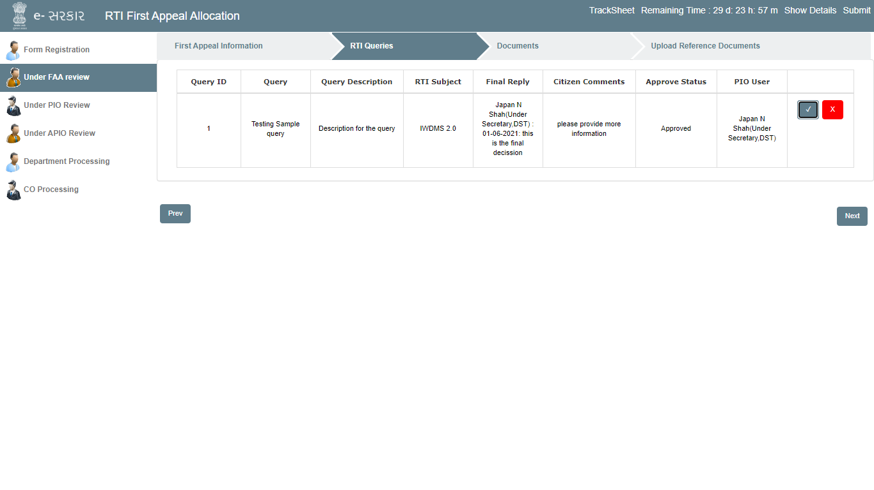
Under FAA Review
FAA user will approve or reject the query by selecting the approve/ reject option.
Once the FAA user approves the FAA request , he will submit the FAA request to the PIO for further processing

Slide 90
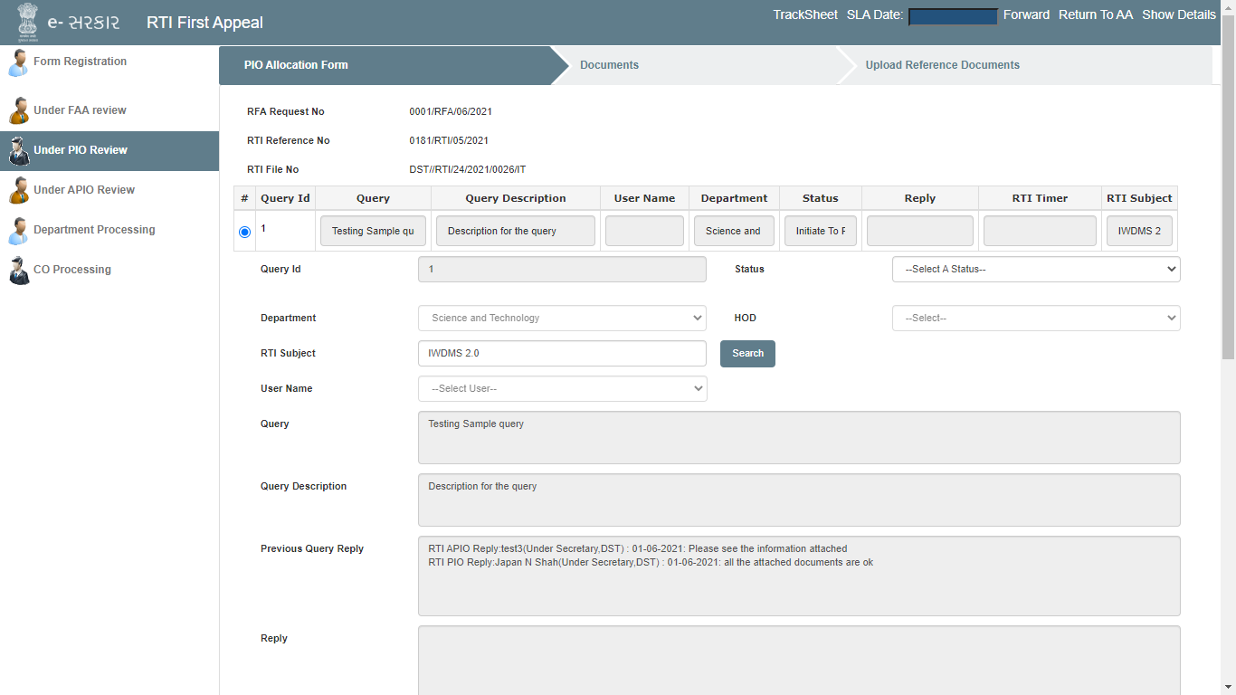
Under FAA Review
Once the FAA request in under PIO, same steps will be applied as before applied on the RTI.
PIO after receiving the details from APIO/DH/CO level user will provide with the RFA final Decision in the RFA final Decision text box and will return it to FAA user.
Click here to return it to FAA

Slide 91
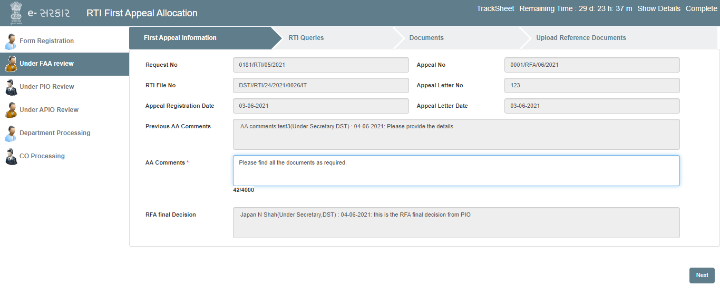
AA comments will be visible to the citizen on the RTI portal in online registered RTI. And all the documents attached will be displayed to the citizen on the RTI portal in online mode if the RTI is registered online else will be manually processed if the RTI is offline registered.
Under FAA Review
Once the First Appeal Authority receives the reply from PIO, FAA user will enter his final comments in AA comments section and will complete the FAA request and put it into the file.
Complete the RFA into file

Slide 92
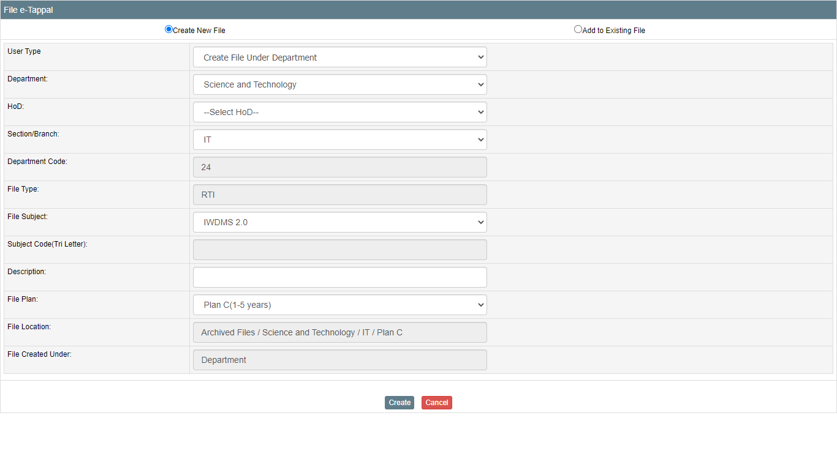
Complete First Appeal
Once the First Appeal has been completed, the First Appeal user will click on the complete button and will navigate to the file screen to create a file or put the documents in the existing file.

Slide 93
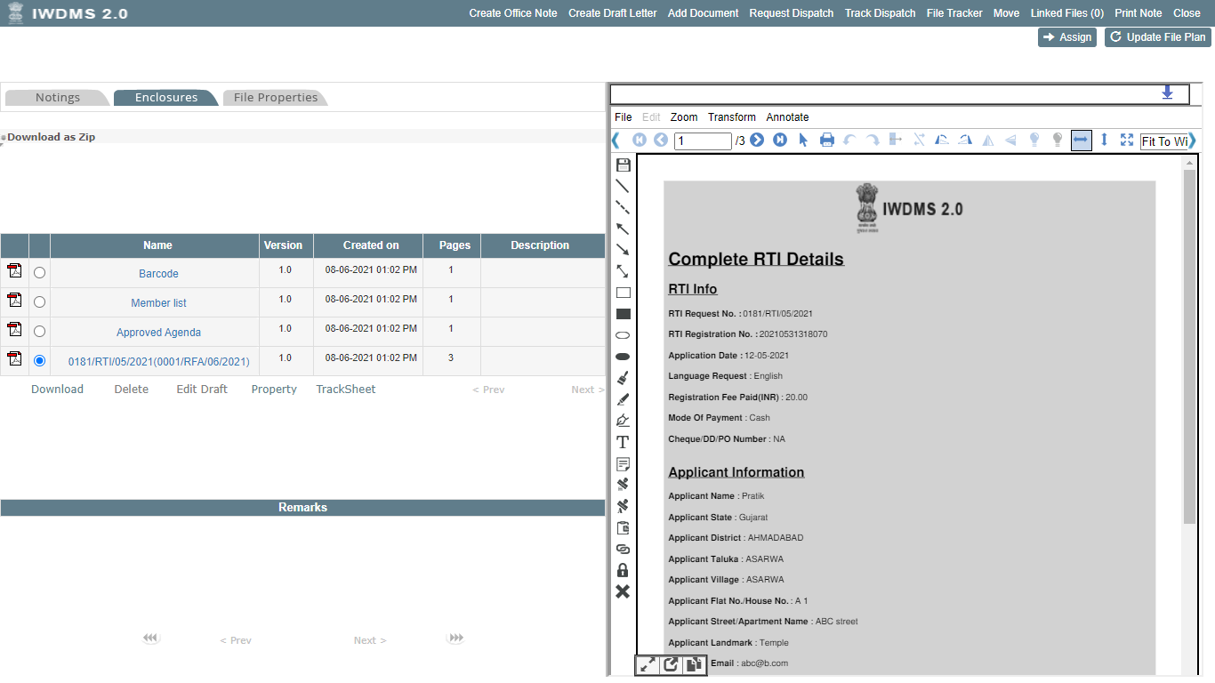
Once the file is created, all the first appeal information is attached to the file under enclosure tab
The first Appeal file can be viewed later for any reference.

Slide 94
Thank You.

