Slide 1
Mechanical Asphyxia
By,
ડો. ચન્દ્રેશ આઇ. ટેલર
ફોરે. મેડિ. & ટોક્ષીકો.
ગવર્ન્મેંટ મેડિકલ કોલેજ,
સુરત

Slide 2
Suffocation
Definition :
Form of asphyxia caused by lack of oxygen in atmosphere or by mechanical obstruction to air passage by mechanical means other than constriction of neck and drowning.
Classification :
Entrapment
Environmental Suffocation
Smothering, overlaying, traumatic asphyxia- External
Chocking, Gagging – Internal means
Burking
Suffocating Gases

Slide 3
Entrapment
Individual trapped in air tight atmosphere.
Initially there is sufficient oxygen; after that sometime of breathing they exhaust and asphyxiate.
Child get trapped in refrigerator which is locked inside.

Slide 4
Smothering
Definition :
Form of asphyxia caused by closing the external respiratory orifices i.e. nose & mouth either by the hand or by other means i.e. mud, paper, cloth plastic bag, duct tape, etc.
Autopsy Finding:
Abrasion or contusion at inner sides of both lips.
Contusion of tongue or teeth mark present.
Fracture of nasal cartilage.
Depression or bleeding from nose.

Slide 5
Body show struggle marks.
Saliva, blood, tissue cells found on pillow.
Tongue protruded and bittened.
Internally if person buried alive in earth, sand particle may found in respiratory tract.
Broken tooth may be seen.
The fracture of nose septum may be seen, along with flattening.
Due to struggle, abrasions or contusions may be seen on cheeks, lower jaw, chest, etc.

Slide 6
Smothering
Abrasion & Contusion over mouth and nostrils
Contused Laceration over inner lips

Slide 7
Contusion & Abrasion in & around lips in new born in case of Smothering

Slide 8
MLI of Smothering
Suicidal
Rare .
Burring the face in mattress or lying against bed clothing.
Individual cut throat wound trachea completely cut soft part obstruct the trachea smothered
Tying the polythene bag over head.
Homicidal
Tying bag around head.
Tying pillow in front of face.

Slide 9
Accidental
Infant of 3 months turns on its face & buried in pillow
Epileptic or intoxicated or unconscious person burying the face in pillow or bed clothes
Person fall into large quantity of material like mud, ashes, grain, sand, coal dust.
Children get suffocated while playing with plastic bags.
New born baby born with membrane around mouth and nostril – Cul De Sac
Tying bag around head causes partial anoxia which is a sexual stimulation in auto erotic death.
Glue sniffing in drug abuse.

Slide 10
Homicidal Smothering

Slide 11
Plastic Bag Suicide

Slide 12
Overlaying
Also known as Compression Suffocation.
There is compression of chest which will prevent movement of chest. There by breathing is impaired and Asphyxia results.
Most common example is mother share the same bed with infant and overlaying occurs.
Along with patechial hemorrhage, there may be evidence of flattening of the nose and face.
Pattern of object involved in compression, is sometimes seen on the infants cheek or body.

Slide 13
Burking
Method of two process: Homicidal Smothering and Traumatic Asphyxia.
Invented by William Burk ( main culprit) and William Hare.
In period of 1927 and 1928, 16 person died due to this method.
As soon as their guest was drunk enough, hare would wrestle him to the floor and closes his mouth and nostrils with his hands, while Burk would sit on the poor victim’s chest. Thus an effective combination of intoxication and asphyxia (smothering + traumatic asphyxia) would result in a quick, non-messy death.

Slide 15
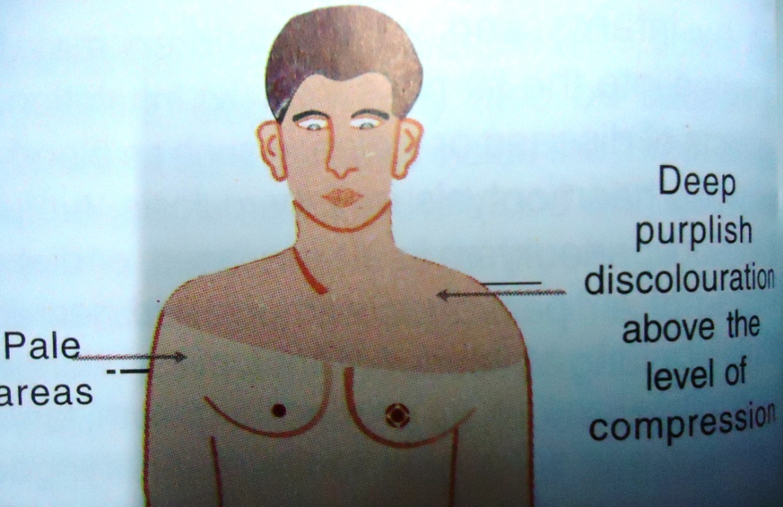
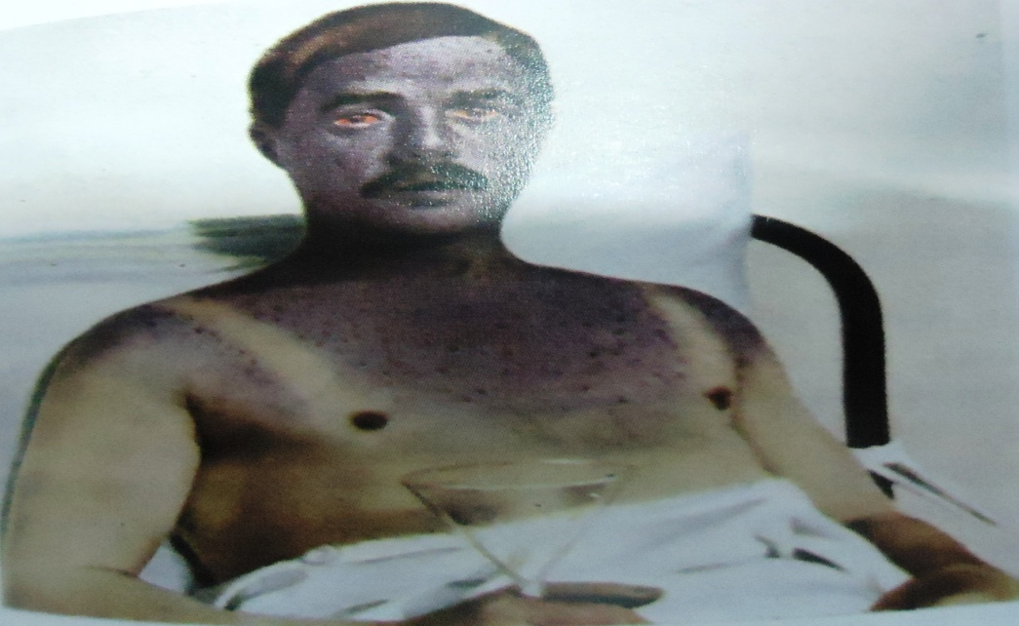
Traumatic Asphyxia
Crush Asphyxia, Compression Asphyxia
Death result from pressure and fixation of chest and abdomen. There by breathing is impaired and Asphyxia results.
It is purely accidental in nature.

Slide 16
For Example:
Multiple death in fire in theatre, bomb blast
Crowd death
Fall of earth or coal mine
Jack sleep and car falls on person.
Earthquake, industrial disaster.
Car accident-wheel struck with chest
House Collapse
Autopsy findings:
Gross congestion, cyanosis and patechia of face, neck and shoulders.
Very dark discoloration of body above the level of obstruction.
Copius bleeding from mouth and nostrils.
Injuries to ribs, vertebra, sternum, lung and heart also.

Slide 17
Traumatic Asphyxia
Gross Congestion of confluent patechial hemorrhage of
face & shoulder
Gross Conjunctival hemorrhage

Slide 18
Traumatic asphyxia showing gross congestion of the face & red blood tinged froth exuding from nostril and mouth

Slide 19
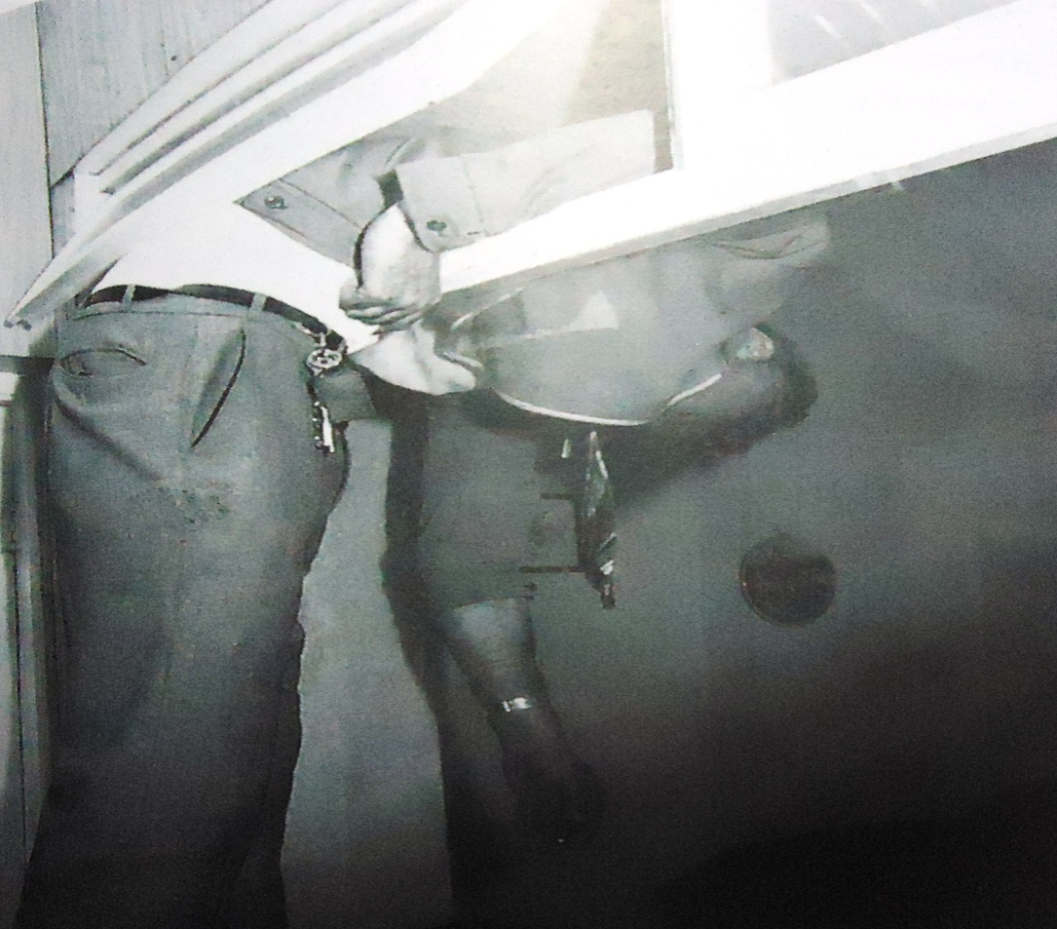
Positional Asphyxia
Cough reflex impaired due to drugs.
Body when subjected to Jack Knife Position.
Forcible flexion of neck on chest.

Slide 20
Gagging
Form of asphyxia result from forcing cloth into the mouth or closure of mouth and nose by cloth or similar material.
Always Homicidal.
Hand and feet are tied to prevent movement of person and also to prevent removing gag from mouth.
Death is sudden due to reflex vagal inhibition.

Slide 21
Chocking
Obstruction occur within air passage.
During meal when food bolus obstruct trachea.
Vomited matter regurgitate into trachea.
Regurgitation of milk in infant.
Food bolus, onion, potato, corn, button, rag, fish, leaves etc.
Penicillin reaction, insect bite will lead to allergic reaction which will lead to edema of larynx.
Blow to front of neck causes mucosal swelling.
Diphtheria, IM, H. Influenza, Tuberculous gland, pharyngeal abscess.

Slide 22
Food Bolus causing Chocking

Slide 23
Cafe Coronary
Healthy intoxicated men when begins meal suddenly turns blue, coughs violently, collapses and then dies.
Death appear to be due to Heart Attack but on autopsy large food bolus seen in trachea.
Coughing reflex is absent due to Alcohol anaesthetize the reflex.

Slide 24
Environmental Suffocation
Individual breathed in atmosphere where there is inadequacy of oxygen.
For example
Mountaining or high attitude.
Decompression
Certain profession in which individual work in underground chamber, petrol or diesel tank, unused deep wells, underground sewage draining system.
Vitiated Atmosphere: Exposure to CO, CO2, methane, sulphurated hydrogen, SO2 etc.

Slide 25
Thank You

