Slide 1
Guide to Use
N-List

Slide 2
Website Address
https://nlist.inflibnet.ac.in/
Use Search Engine – www.google.com
Search for “N-List”

Slide 3
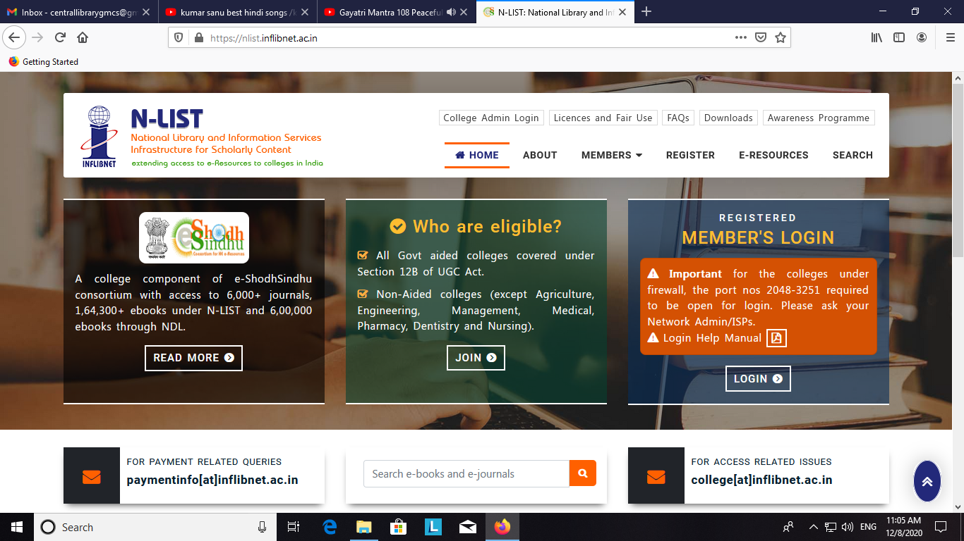

Slide 4
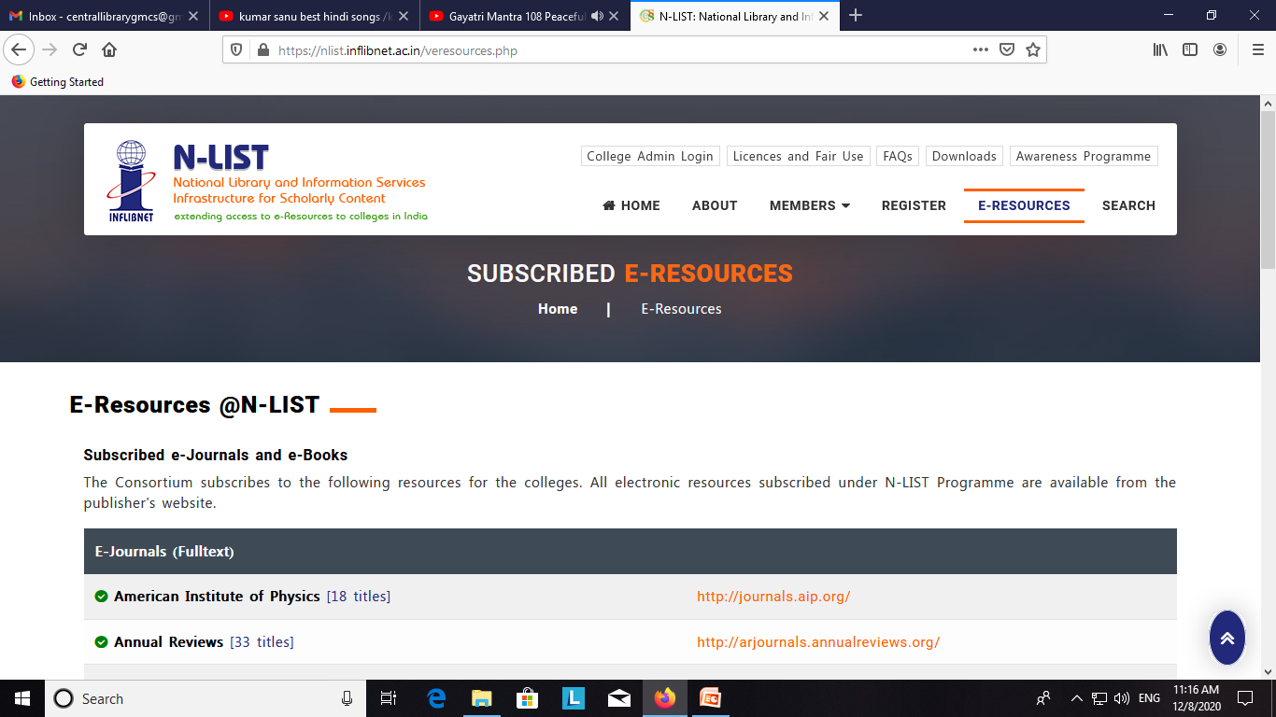

Slide 5
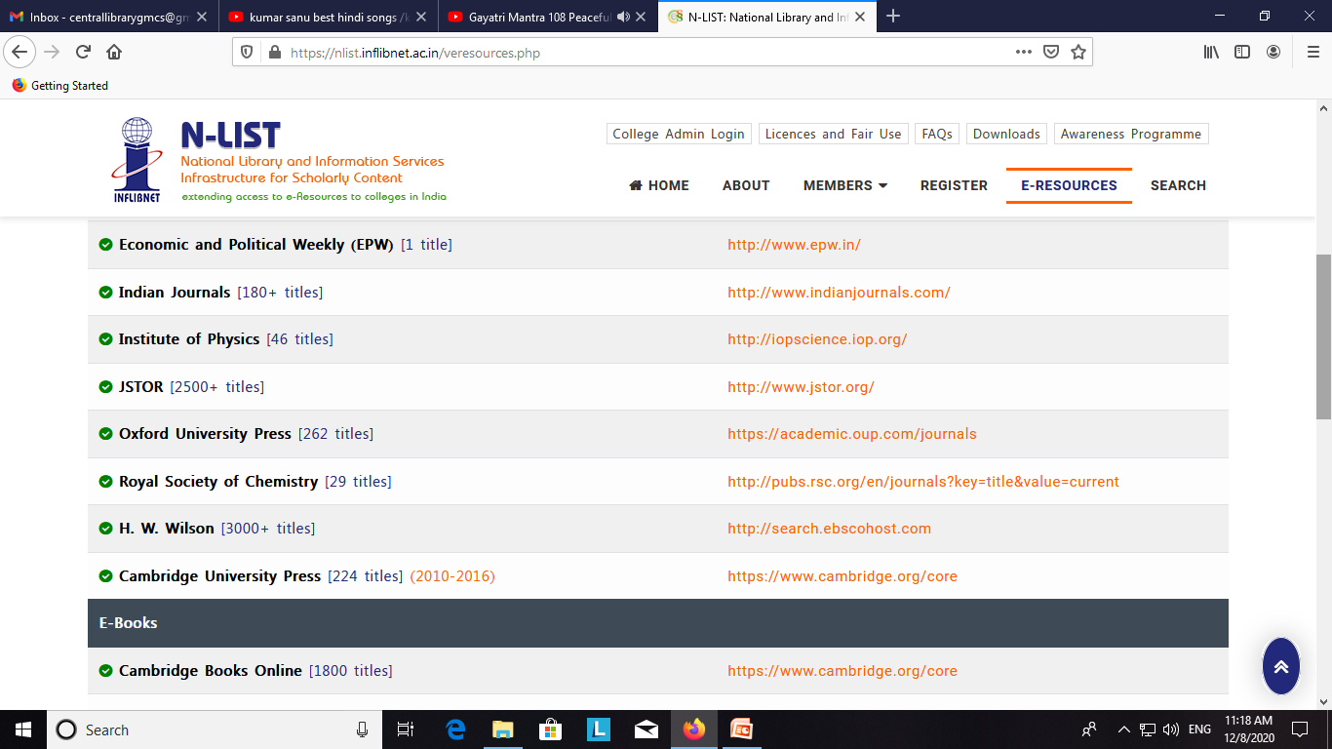

Slide 6
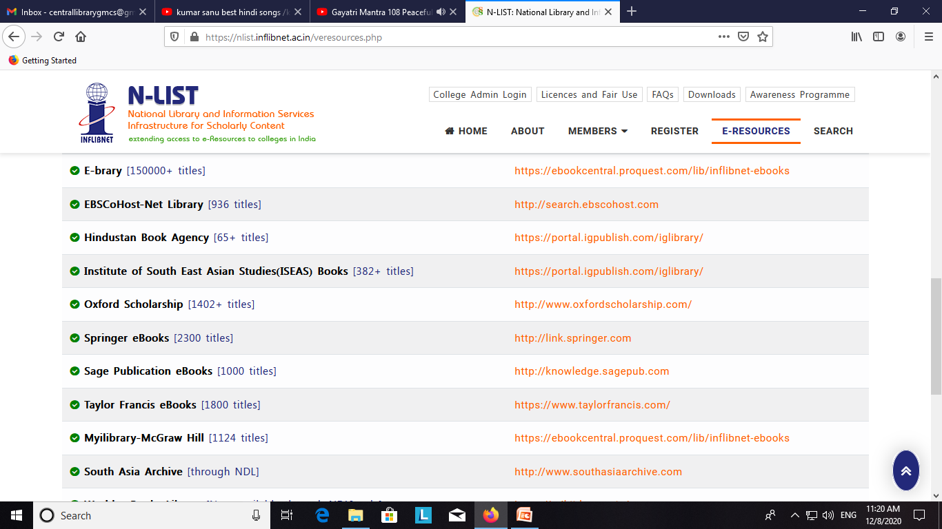

Slide 7
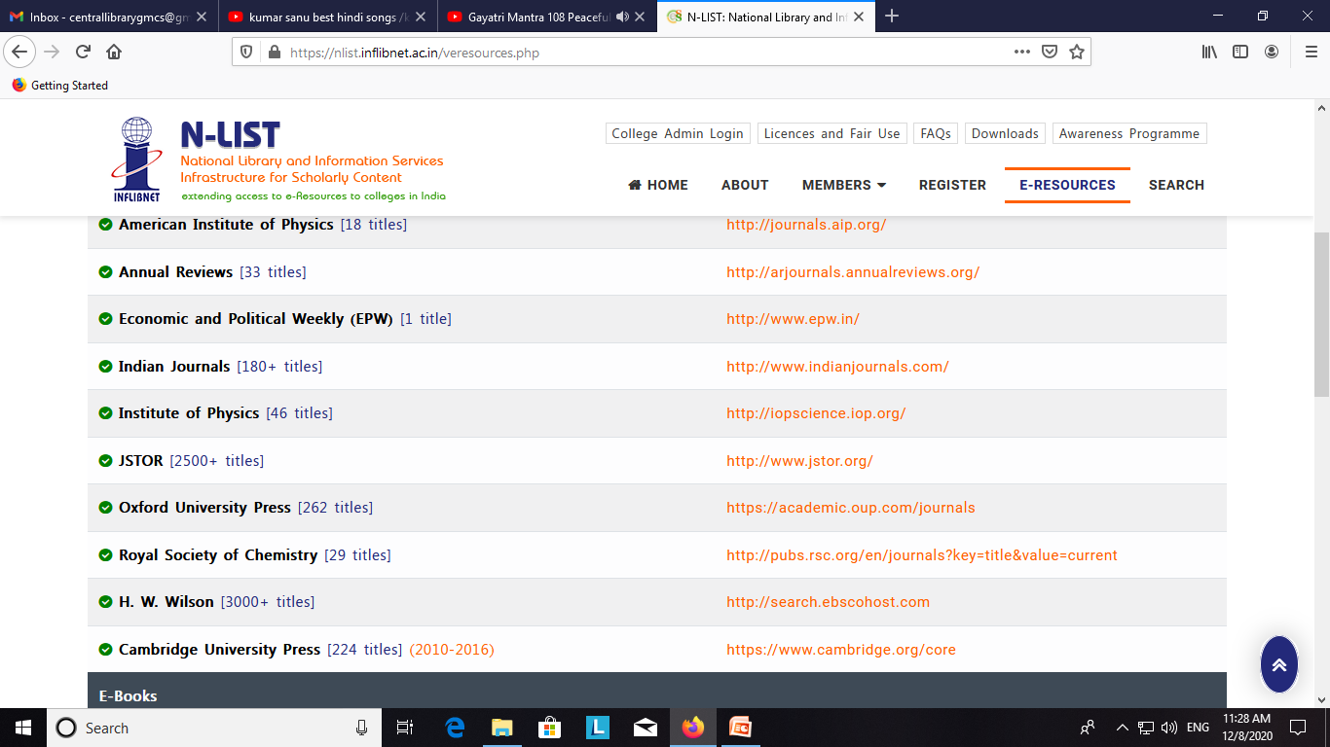

Slide 8
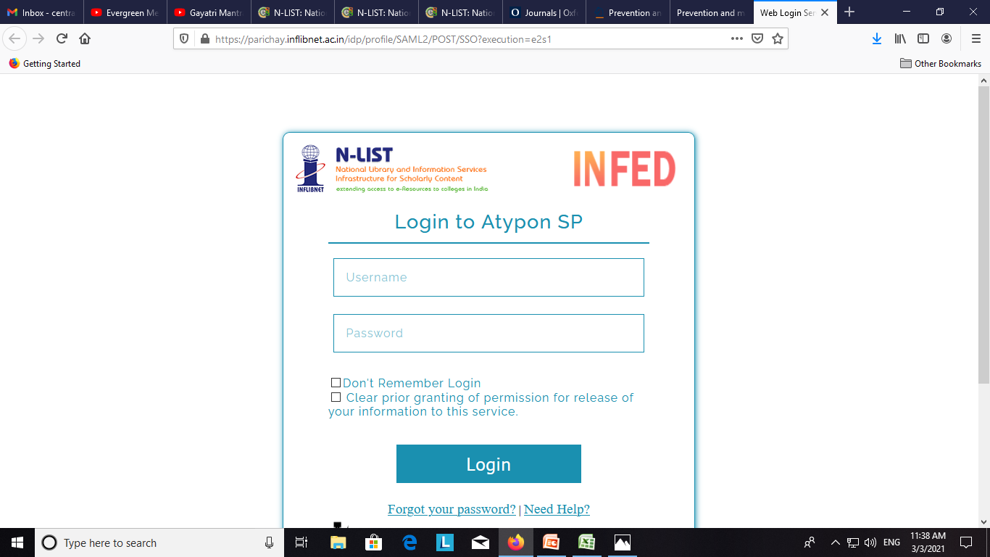

Slide 9
Name of Department | Email - Usename
Dr. Ritambhara Mehta - Admin | nlist.gmcs@gmail.com
Ritambhara Mehta | ritambharam@yahoo.com
Physiology | physiology.gmcsurat@gmail.com
Dental | dentaldept.gmcsurat@gmail.com
Microbiology | microbiologydept.gmcsurat@gmail.com
Pathology | pathologydept.gmcsurat@gmail.com
PSM | psmdept.gmcsurat@gmail.com
Pharmacology | pharmacology.gmcsurat@gmail.com
Biochemistry | biochemistrydept.gmcsurat@gmail.com
Buns & Plastic surgery | burnsplastic.gmcsurat@gmail.com
Medicine | medicinedept.gmcsurat@gmail.com
Surgery | surgery.gmcsurat@gmail.com
Orthopedic | orthodept.gmcsurat@gmail.com
Paediatrics | paediatrics.gmcsurat@gmail.com
Radiology | radiologydept.gmcsurat@gmail.com
TB & Chest | tbchestdept.gmcsurat@gmail.com
Emergency Medicine | emsdept.gmcsurat@gmail.com
Opthalmology | opthal.gmcsurat@gmail.com
O&G | ogdept.gmcsurat@gmail.com
IHBT | ihbtdept.gmcsurat@gmail.com
Anesthesia | anesthesiology.gmcsurat@gmail.com
Anatomy | anatomydept.gmcsurat@gmail.com
Ent | entdept.gmcsurat@gmail.com
Ritabhara Mehta | psychiatrydept.gmcsurat@gmail.com
Skin & Vd | skinvddept.gmcsurat@gmail.com
Forensic Medicine | fmdept.gmcsurat@gmail.com

Slide 10
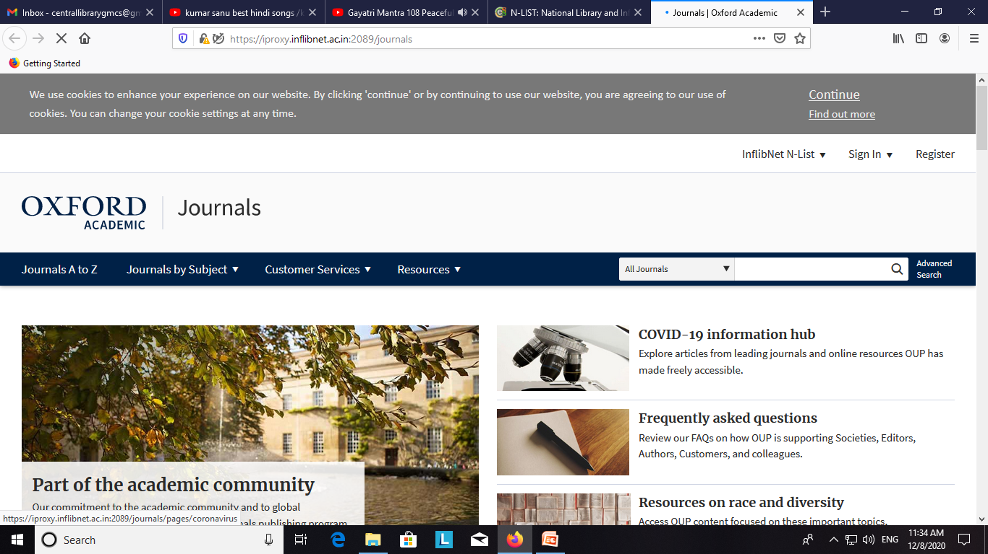

Slide 11
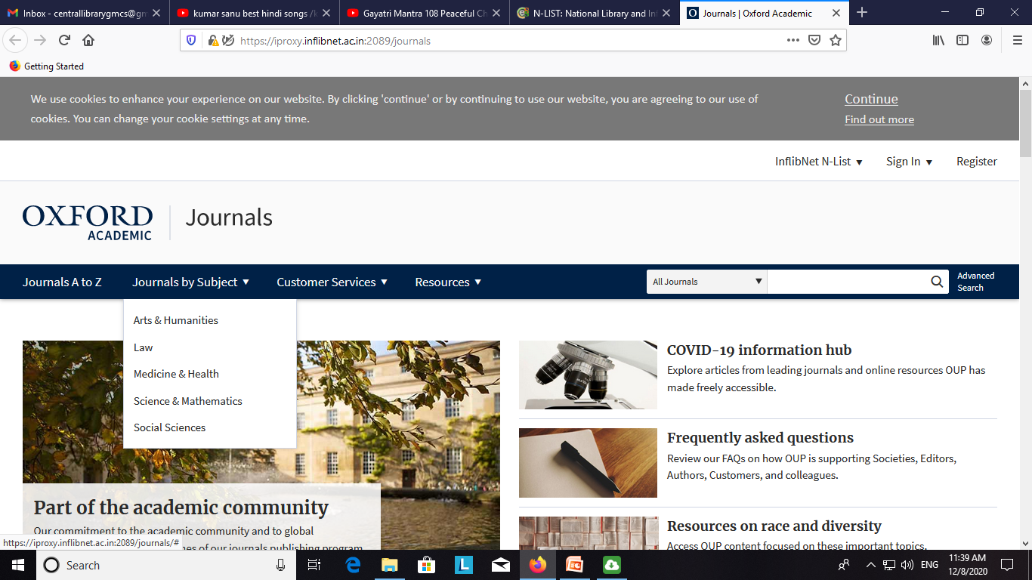

Slide 12
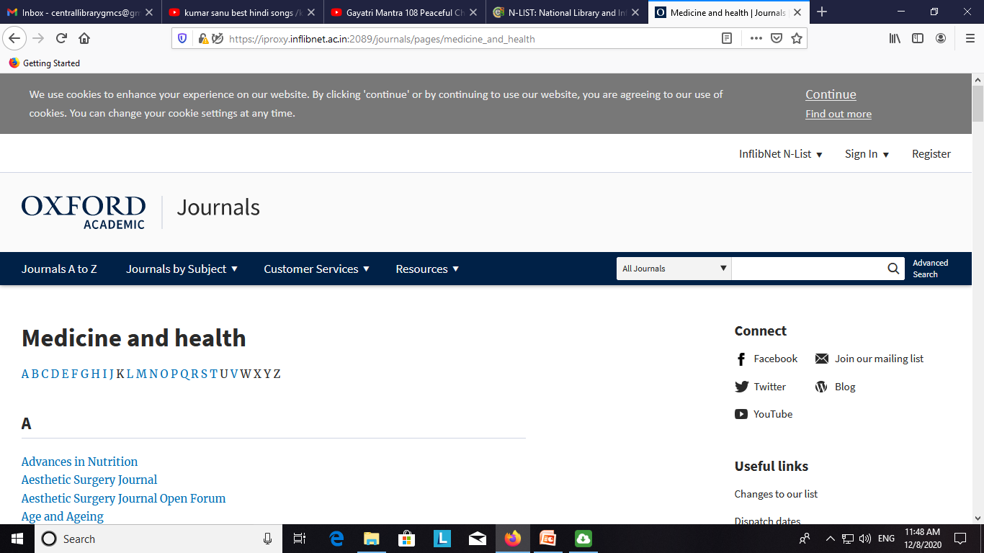

Slide 13
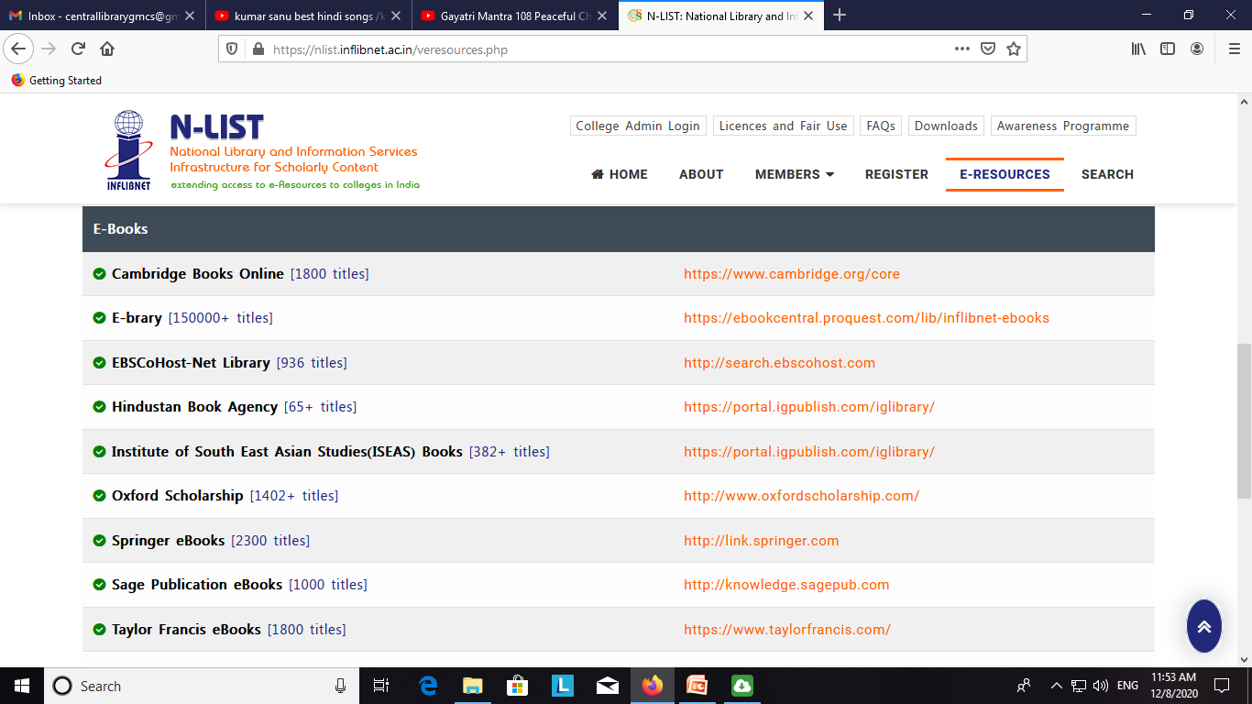

Slide 14
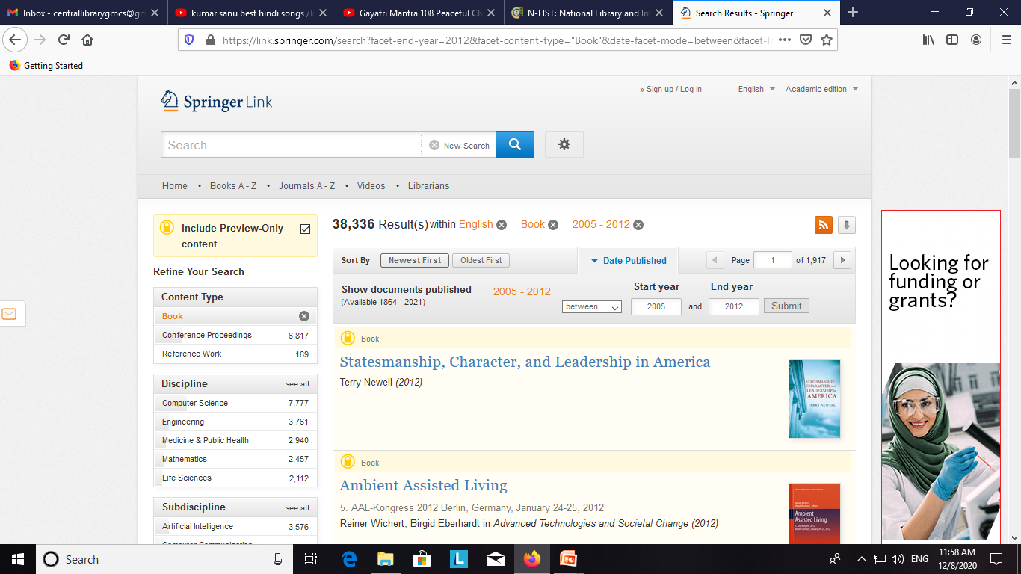

Slide 15
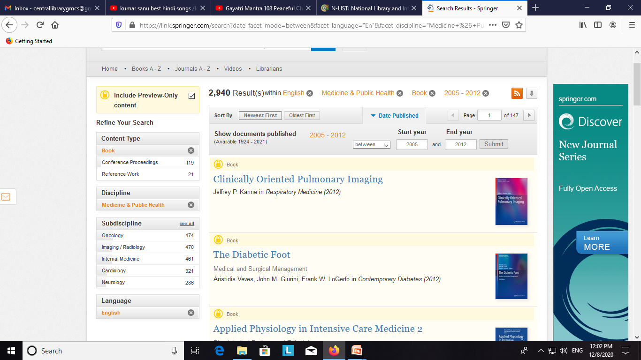

Slide 16
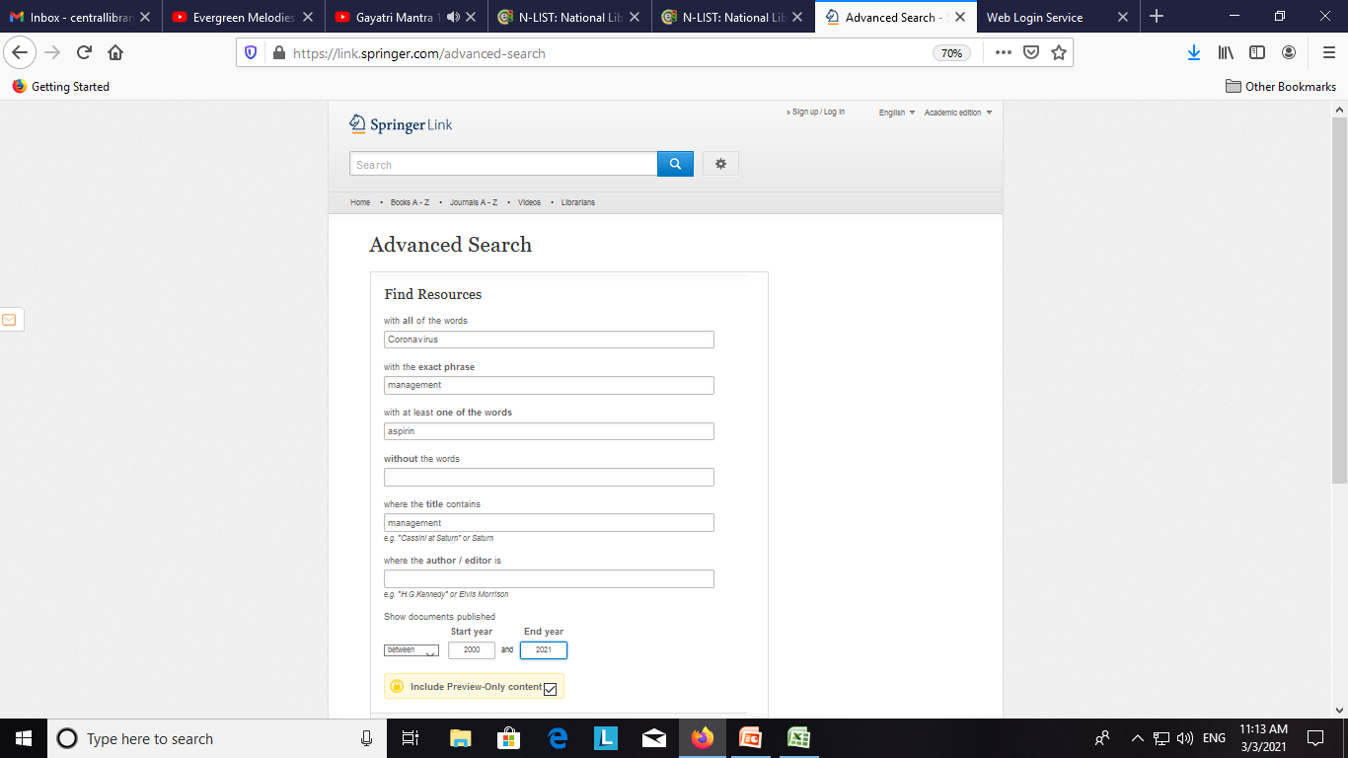

Slide 17
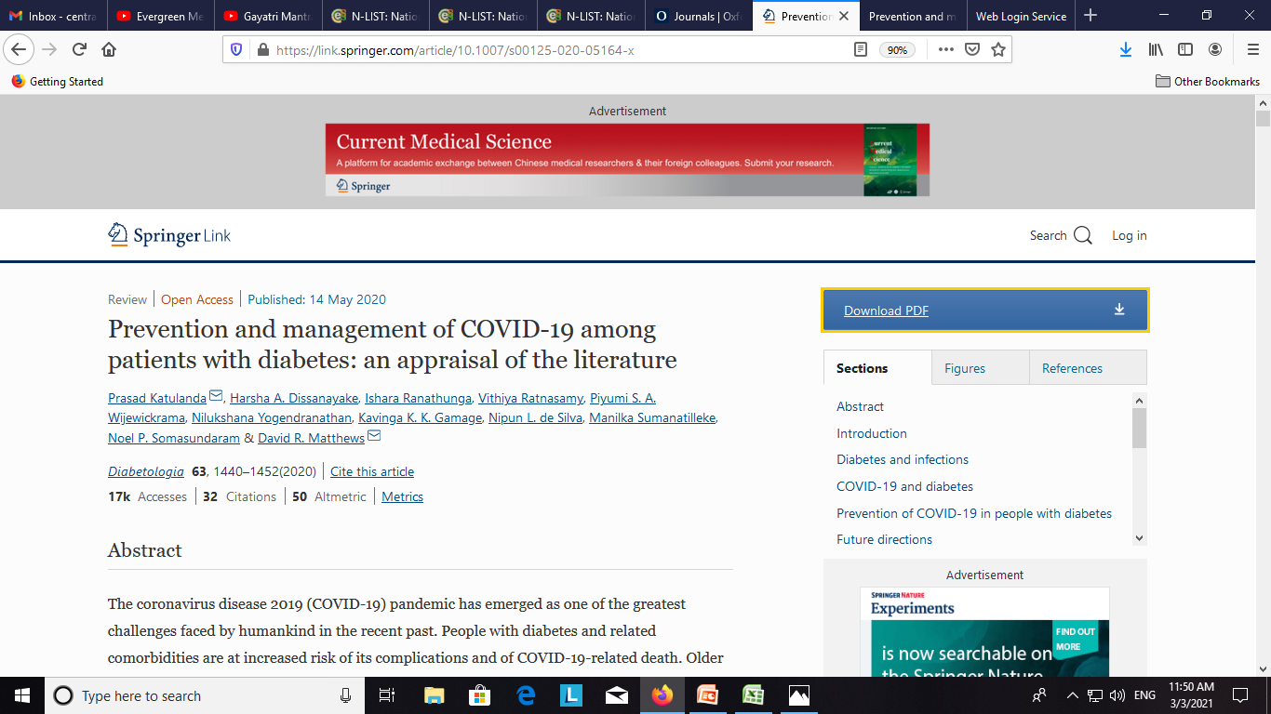

Slide 18
